Slide 1
Value-Added Network Workshop
May 2013

Slide 2
Agenda
8:30-10:30 Value-Added Growth Model Overview and Refresher
10:45-11:00 Welcome, Introductions
11:00-11:30 Wisconsin Teacher Effectiveness
11:30-12:00 Keynote Luncheon: Why Value-Added?
12:00-12:45 Your Value-Added Reports
12:45-3:15 Breakout Sessions (Pick 3)
3:15-3:30 Networking, Wrap up, and Evaluation

Slide 3
Feedback Survey (for 8:30-10:30 session)
Please help us improve Value-Added training and resources for the future

Slide 4
VARC Introduction Review
Sean McLaughlin - VARC

Slide 5
Our Website: http://varc.wceruw.org/
Go to Projects

Slide 6
Our Website: http://varc.wceruw.org/
Wisconsin
State-Wide

Slide 7
Our Website: http://varc.wceruw.org/
May 2013 Value-Added Network Workshop

Slide 8
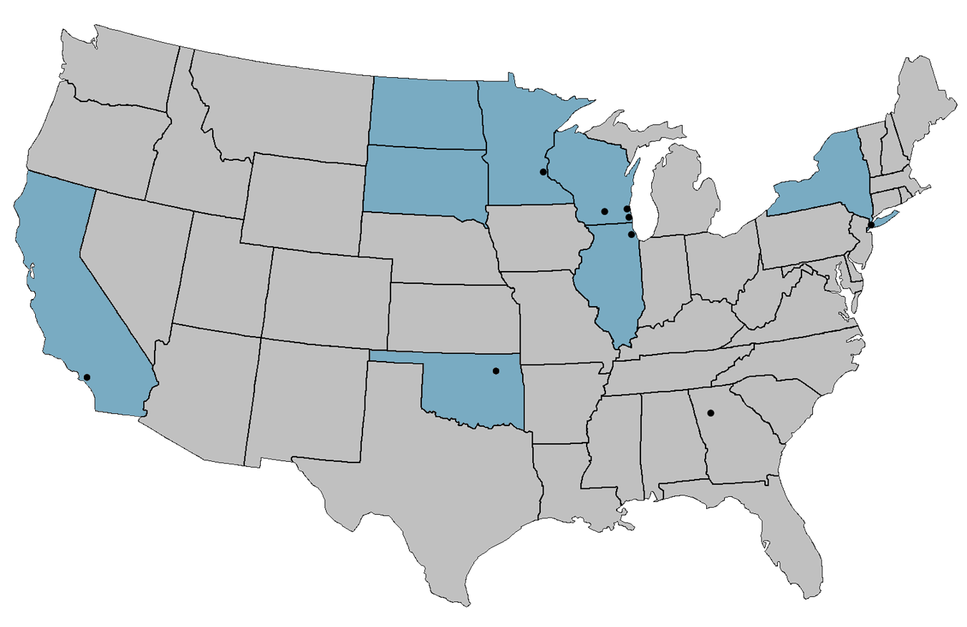
Districts and States Working with VARC
NORTH DAKOTA
MINNESOTA
Minneapolis
WISCONSIN
SOUTH DAKOTA
Milwaukee
NEW YORK
Madison
Racine
Chicago
New York City
ILLINOIS
CALIFORNIA
Tulsa
OKLAHOMA
Atlanta
Los Angeles
Hillsborough County
Collier County
Notes:
VARC story: founded in 2005 with Minneapolis schools and has expanded to all of these places around the U.S.
Today, a staff of over 50 faculty, researchers, education professionals, and data system specialists provide a variety of cross-disciplinary expertise.
They drive groundbreaking work on value-added and education analytics, education policy, professional development, and data-driven decision-making.

Slide 9
Achievement and Value-Added
For the most complete picture of student and school performance, it is best to look at both Achievement and Value-Added.
This will tell you:
What students know at a point in time (Achievement)
How your school is affecting student academic growth (Value-Added)

Slide 10
The Power of Two
&
Achievement
Value-Added
Compares students’ performance to a standard
Measures students’ individual academic growth longitudinally
A more complete picture of student learning
Does not factor in students’ background characteristics
Factors in students’ background characteristics outside of the school’s control
Measures students’ performance at a single point in time
Measures the impact of teachers and schools on academic growth
Critical to students’ post-secondary opportunities
Critical to ensuring students’ future academic success
Adapted from materials created by Battelle for Kids

Slide 11
VARC Design Process: Continuous Improvement
Objective
Model Co-Build
Output
Stakeholder Feedback
Valid and fair comparisons of teachers serving different student populations
Productivity estimates (contribution to student academic growth)
New objectives
Model refinement
Full disclosure: no black-box
Model informed by technical and consequential validity
Data formatting
Notes:
This is an alternative to the “Objective Design Output” slide that’s more user friendly and emphasizes that this is a process

Slide 12
The Oak Tree Analogy
Notes:
This presentation is the most popular and successful introduction to Value-Added analysis that VARC has produced.
Sean feels this is almost always an appropriate analogy to present.
For more technical or experienced audiences, this can serve as an example of how to explain Value-Added modeling to less well versed audiences.
There is also a “short version” of this presentation on workspace for a condensed presentation of this content.

Slide 13
The Oak Tree Analogy
Notes:
This Oak Tree Analogy was created to introduce the concept of value added calculations. It is not in the education context in an attempt to keep this overview of the theory of value added separate from details specific to its use in education.

Slide 14
Explaining Value-Added by Evaluating Gardener Performance
For the past year, these gardeners have been tending to their oak trees trying to maximize the height of the trees.
Gardener A
Gardener B
Notes:
In this analogy, we will be explaining the concept of value added by evaluating the performance of two gardeners.
For the past year, these gardeners have been tending to their oak trees trying to maximize the height of the trees. Each gardener used a variety of strategies to help their own tree grow. We want to evaluate which of these two gardeners was more successful with their strategies.

Slide 15
Method 1: Measure the Height of the Trees Today (One Year After the Gardeners Began)
Using this method, Gardener B is the more effective gardener.
This method is analogous to using an Achievement Model.
Gardener A
72 in.
Gardener B
61 in.
Notes:
To measure the performance of the gardeners, we will measure the height of the trees today, 1 year after they began tending to the trees.
With a height of 61 inches for Oak Tree A and 72 inches for Oak Tree B, we find Gardener B to be the better gardener.
This method is analogous to using an achievement Model to evaluate performance.

Slide 16
Pause and Reflect
How is this similar to how schools have been evaluated in the past?
What information is missing from our gardener evaluation?
Notes:
Audience participation:
Evaluating the effectiveness of the gardeners based on ending height of the trees is like evaluating schools or teachers based on ending attainment/achievement of students.
Under No Child Left Behind, schools and teachers serving high achieving students were at an advantage. Generally, rich suburban schools and teachers systematically were higher rated than schools in poorer urban environments. This has more to do with the student populations than the effectiveness of the schools.
Keep in mind audience suggestions about what is missing can fall into things within or outside of the gardeners’ control.
If something like “fertilizer” is suggested, keep in mind that the gardeners have control over that factor. If fertilizer (or something to that effect) is mentioned, bring up the distinction on the “What about factors outside the gardener’s influence?” slide.
Fertilizer is a strategy we’re trying to measure rather than an outside factor we want to control for.

Slide 17
This Achievement Result is not the Whole Story
We need to find the starting height for each tree in order to more fairly evaluate each gardener’s performance during the past year.
Gardener A
72 in.
Gardener B
61 in.
52 in.
47 in.
Oak A
Age 3
(1 year ago)
Oak A
Age 4
(Today)
Oak B
Age 3
(1 year ago)
Oak B
Age 4
(Today)
Notes:
…but this achievement result does not tell the whole story.
These gardeners did not start with acorns. The trees are 4 years old at this point in time.
We need to find the starting height for each tree in order to more fairly evaluate each gardener’s performance during the past year.
Looking back at our yearly record, we can see that the trees were much shorter last year.

Slide 18
Method 2: Compare Starting Height to Ending Height
Oak B had more growth this year, so Gardener B is the more effective gardener.
This is analogous to a Simple Growth Model, also called Gain.
Gardener A
+20 in.
72 in.
Gardener B
+14 in.
61 in.
52 in.
47 in.
Oak A
Age 3
(1 year ago)
Oak A
Age 4
(Today)
Oak B
Age 3
(1 year ago)
Oak B
Age 4
(Today)
Notes:
We can compare the height of the trees one year ago to the height today.
By finding the difference between these heights, we can determine how many inches the trees grew during the year of gardener’s care.
By using this method, Gardener A’s tree grew 14 inches while Gardener B’s tree grew 20 inches. Oak B had more growth this year, so Gardener B is the better gardener.
This is analogous to using a Simple Growth Model, also called Gain.

Slide 19
What About Factors Outside the Gardener’s Influence?
This is an “apples to oranges” comparison.
For our oak tree example, three environmental factors we will examine are: Rainfall, Soil Richness, and Temperature.
Gardener A
Gardener B
Notes:
But this Simple Growth result does not tell the whole story either.
Although we know how many inches the trees grew during this year, we do not yet know how much of this growth was due to the strategies used by the gardeners themselves.
This is an “apples to oranges” comparison.
If we really want to fairly evaluate the gardeners, we need to take into account other factors that influenced the growth of the trees.
For our oak tree example, three environmental factors we will examine are: Rainfall, Soil Richness, and Temperature.

Slide 20
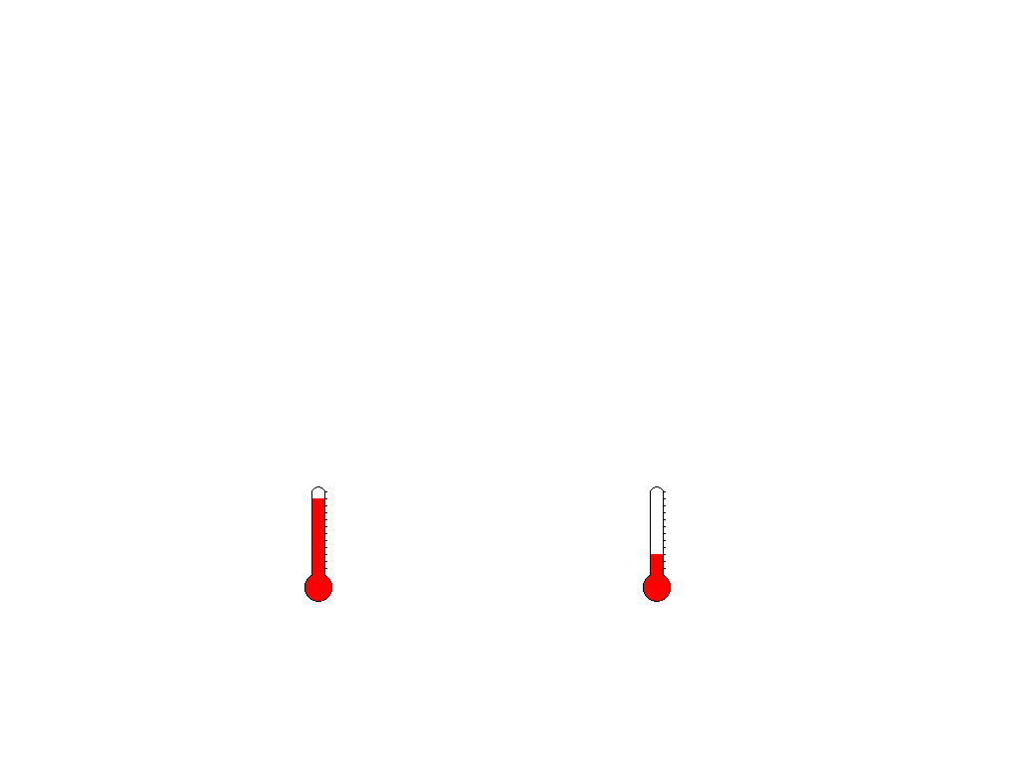
External condition | Oak Tree A | Oak Tree B
Rainfall amount
Soil richness
Temperature
High Low
Low High
High Low
Gardener A
Gardener B
Notes:
Based on the data for our trees, we can see what kind of external conditions our two trees experienced during the last year.
Oak Tree A was in a region with High rainfall while Oak Tree B experienced Low rainfall.
Oak Tree A had low soil richness while Oak Tree B has high soil richness.
Oak Tree A had high temperature while Oak Tree B had low temperature.

Slide 21
How Much Did These External Factors Affect Growth?
We need to analyze real data from the region to predict growth for these trees.
We compare the actual height of the trees to their predicted heights to determine if the gardener’s effect was above or below average.
Gardener A
Gardener B
Notes:
We can use this information to calculate a predicted height for each tree today if it was being cared for by an average gardener in the area.
We examine all oaks in the region to find an average height improvement for trees.
We adjust this prediction for the effect of each tree’s environmental conditions.
We compare the actual height of the trees to their predicted heights to determine if the gardener’s effect was above or below average.

Slide 22
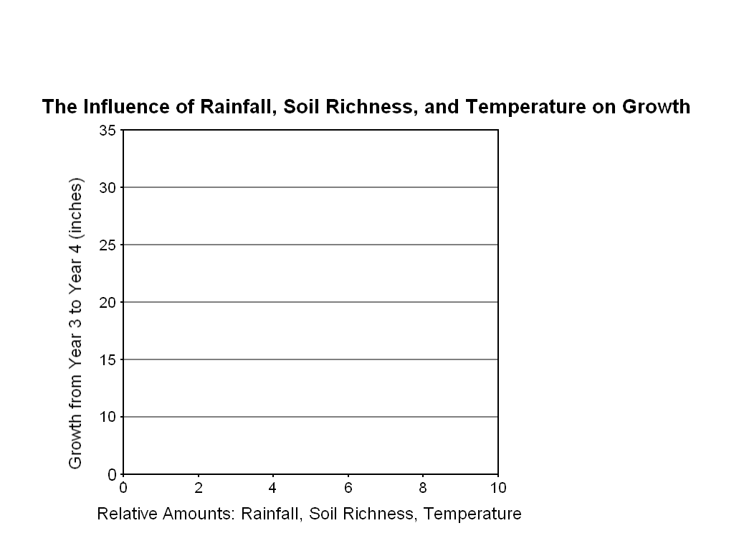
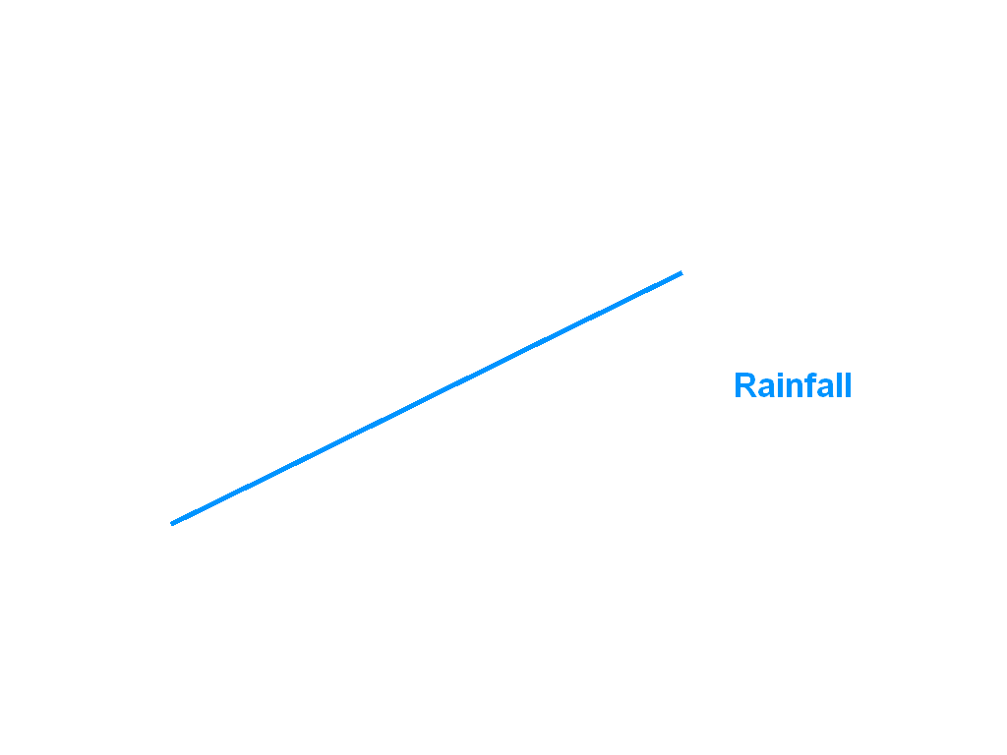
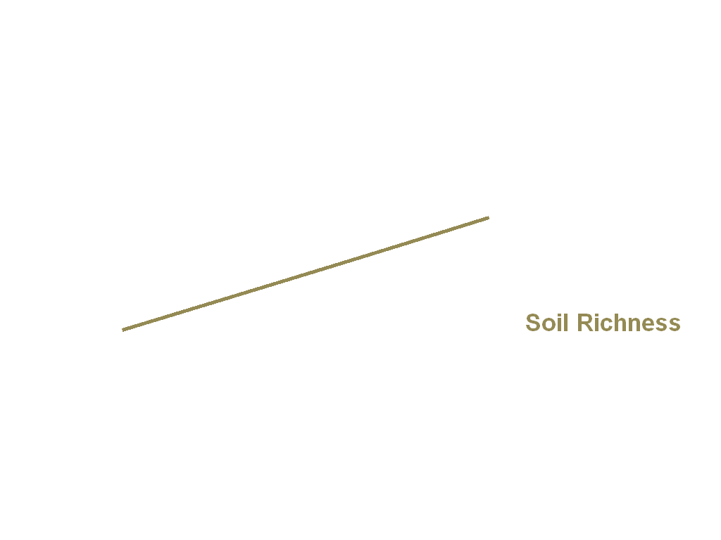
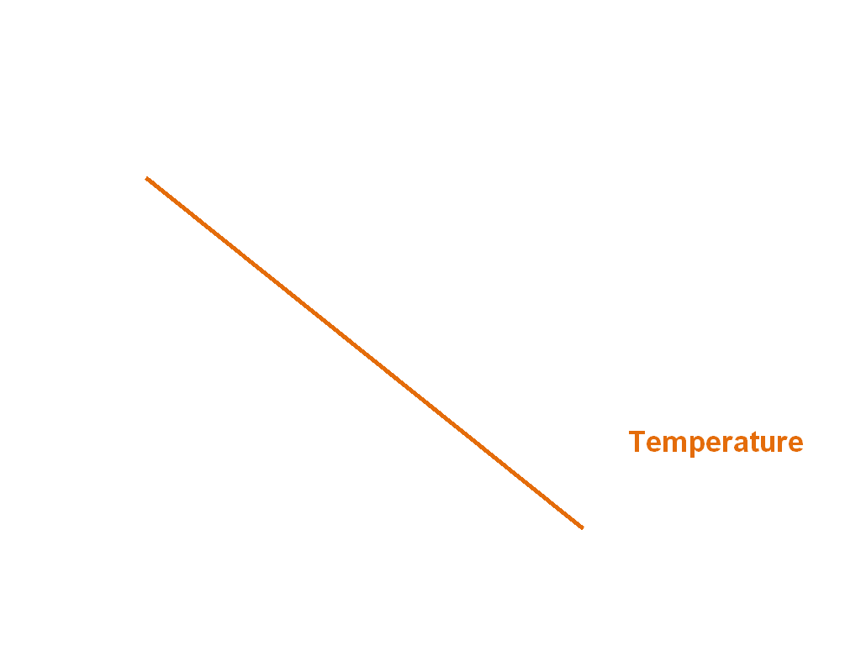
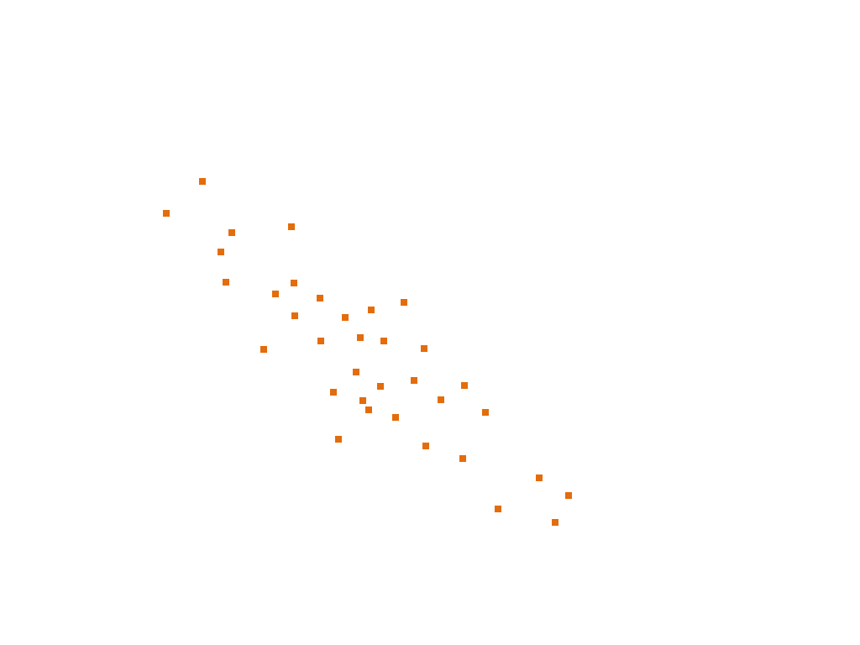
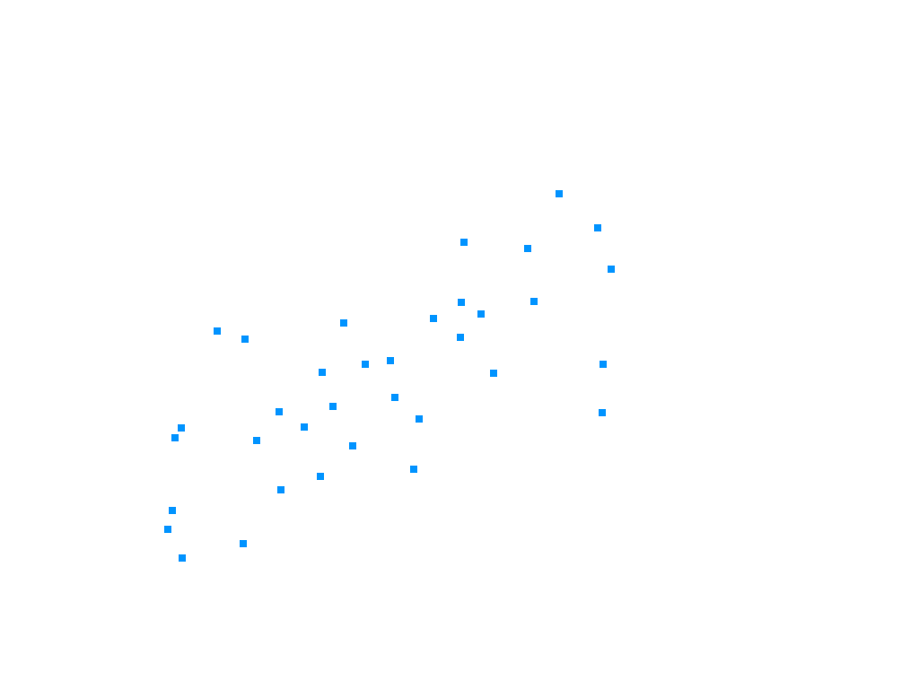
In order to find the impact of rainfall, soil richness, and temperature, we will plot the growth of each individual oak in the region compared to its environmental conditions.
Notes:
In order to find the impact of rainfall, soil richness, and temperature, we will plot the growth of each individual oak in the region compared to its environmental conditions.
On the x-axis, we plot the relative amount of each environmental condition. On the y-axis, we plot how much each tree grew from year 3 to year 4.
Each dot represents a single oak tree in the area. By calculating an average line through the data, we can determine a trend for each environmental factor.
From the data we collected for our region, we find that more rainfall and higher soil richness contributed positively to growth. Higher temperatures contributed negatively to growth.
Keep in mind: this is a stylized example of using “real data” to find out how much these factors influence growth. In reality, VARC uses a multivariate linear regression model to determine the effect of external factors.

Slide 23
Calculating Our Prediction Adjustments Based on Real Data
Rainfall | Low | Medium | High
Growth in inches relative to the average | -5 | -2 | +3
Soil Richness | Low | Medium | High
Growth in inches relative to the average | -3 | -1 | +2
Temperature | Low | Medium | High
Growth in inches relative to the average | +5 | -3 | -8
Notes:
Now that we have identified growth trends for each of these environmental factors, we need to convert them into a form usable for our predictions.
We can summarize our trend information by determining a numerical adjustment based on High, Medium, and Low amount of each environmental condition.
For example, based on our data, we found that oak trees that experienced low rainfall tended to have 5 fewer inches of growth compared to the average growth of oak trees in the region.
Trees with medium rainfall tended to have 2 fewer inches of growth compared to the average. Trees with high rainfall tended to have 3 more inches of growth compared to the average.
We calculate these numerical adjustments for all environmental conditions to summarize the trends from the data.
Now we can go back to Oak A and Oak B to adjust for their growing conditions.

Slide 24
Make Initial Prediction for the Trees Based on Starting Height
Next, we will refine out prediction based on the growing conditions for each tree. When we are done, we will have an “apples to apples” comparison of the gardeners’ effect.
Gardener A
72 in.
Gardener B
67 in.
52 in.
47 in.
+20 Average
+20 Average
Oak A
Age 3
(1 year ago)
Oak A
Prediction
Oak B
Age 3
(1 year ago)
Oak B
Prediction
Notes:
To make our initial prediction, we use the average height improvement for all trees.
Based on our data, the average improvement for oak trees in the region was 20 inches during the past year.
We start with the trees’ height at age 3 and add 20 inches for our initial prediction.
Next, we will refine our prediction based on the growing conditions for each tree. When we are done, we will have an “apples to apples” comparison of the gardeners’ effect.

Slide 25
Based on Real Data, Customize Predictions based on Rainfall
For having high rainfall, Oak A’s prediction is adjusted by +3 to compensate.
Similarly, for having low rainfall, Oak B’s prediction is adjusted by -5 to compensate.
Gardener A
70 in.
67 in.
Gardener B
52 in.
47 in.
+20 Average
+20 Average
+ 3 for Rainfall
- 5 for Rainfall
Notes:
Based on data for all oak trees in the region, we found that high rainfall resulted in 3 inches of extra growth on average.
For having high rainfall, Oak A’s prediction is adjusted by +3 to compensate.
Similarly, for having low rainfall, Oak B’s prediction is adjusted by -5 to compensate.

Slide 26
Adjusting for Soil Richness
For having poor soil, Oak A’s prediction is adjusted by -3.
For having rich soil, Oak B’s prediction is adjusted by +2.
Gardener A
69 in.
Gardener B
67 in.
52 in.
47 in.
+20 Average
+20 Average
+ 3 for Rainfall
- 5 for Rainfall
- 3 for Soil
+ 2 for Soil
Notes:
We continue this process for our other environmental factors.
For having poor soil, Oak A’s prediction is adjusted by -3.
For having rich soil, Oak B’s prediction is adjusted by +2.

Slide 27
Adjusting for Temperature
For having high temperature, Oak A’s prediction is adjusted by -8.
For having low temperature, Oak B’s prediction is adjusted by +5.
74 in.
Gardener A
Gardener B
59 in.
52 in.
47 in.
+20 Average
+20 Average
+ 3 for Rainfall
- 5 for Rainfall
- 3 for Soil
+ 2 for Soil
- 8 for Temp
+ 5 for Temp
Notes:
For having high temperature, Oak A’s prediction is adjusted by -8.
For having low temperature, Oak B’s prediction is adjusted by +5.

Slide 28
Our Gardeners are Now on a Level Playing Field
The predicted height for trees in Oak A’s conditions is 59 inches.
The predicted height for trees in Oak B’s conditions is 74 inches.
74 in.
Gardener A
Gardener B
59 in.
52 in.
47 in.
+20 Average
+20 Average
+ 3 for Rainfall
- 5 for Rainfall
- 3 for Soil
+ 2 for Soil
- 8 for Temp
+ 5 for Temp
_________
+12 inches
During the year
_________
+22 inches
During the year
Notes:
Now that we have refined our predictions based on the effect of environmental conditions, our gardeners are on a level playing field.
The predicted height for trees in Oak A’s conditions is 59 inches.
The predicted height for trees in Oak B’s conditions is 74 inches.

Slide 29
Compare the Predicted Height to the Actual Height
Oak A’s actual height is 2 inches more than predicted. We attribute this to the effect of Gardener A.
Oak B’s actual height is 2 inches less than predicted. We attribute this to the effect of Gardener B.
-2
74 in.
72 in.
Gardener A
+2
Gardener B
61 in.
59 in.
Predicted
Oak A
Actual
Oak A
Predicted
Oak B
Actual
Oak B
Notes:
Finally, we compare the actual height of the trees to our predictions.
Oak A’s actual height of 61 inches is 2 inches more than we predicted. We attribute this above-average result to the effect of Gardener A.
Oak B’s actual height of 72 inches is 2 inches less than we predicted. We attribute this below-average result to the effect of Gardener B.

Slide 30
Method 3: Compare the Predicted Height to the Actual Height
By accounting for last year’s height and environmental conditions of the trees during this year, we found the “value” each gardener “added” to the growth of the trees.
This is analogous to a Value-Added measure.
-2
74 in.
72 in.
Gardener A
+2
Gardener B
61 in.
59 in.
Above
Average
Value-Added
Below
Average
Value-Added
Predicted
Oak A
Actual
Oak A
Predicted
Oak B
Actual
Oak B
Notes:
Using this method, Gardener A is the superior gardener.
By accounting for last year’s height and environmental conditions of the trees during this year, we have found the “value” each gardener “added” to the growth of the tree.
This is analogous to a value added measure.

Slide 31
Value-Added Basics – Linking the Oak Tree Analogy to Education

Slide 32
How does this analogy relate to value added in the education context?
 | Oak Tree Analogy | Value-Added in Education
What are we evaluating? | Gardeners | Districts Schools Grades Classrooms Programs and Interventions
What are we using to measure success? | Relative height improvement in inches | Relative improvement on standardized test scores
Sample | Single oak tree | Groups of students
Control factors | Tree’s prior height Other factors beyond the gardener’s control: Rainfall Soil richness Temperature | Students’ prior test performance (usually most significant predictor) Other demographic characteristics such as: Grade level Gender Race / Ethnicity Low-Income Status ELL Status Disability Status Section 504 Status
Notes:
This analogy was purposefully kept out of the education context. How does this analogy relate to value added estimates in the education context?
What are we evaluating? In the oak tree analogy, we evaluated gardeners. In the education context, we are evaluating districts, schools, grades, classrooms, programs, and interventions.
What are we using to measure success? In the oak tree analogy, we measure relative height improvement in inches. In the education context, we measure relative improvement on standardized test scores.
What about our sample? In the oak tree analogy, we only used a single oak tree per gardener. In the education context, we use groups of students.
What do we control for? In the oak tree analogy, we accounted for the tree’s prior height and analyzed data for rainfall, soil richness, and temperature. We were then able to incorporate their influence in our prediction. We call this “controlling” for these factors. In the education context, we control for prior performance. This tends to be the most significant predictor of student performance. Based on what other data is available, we also control for other factors beyond the district, school, or classroom’s influence, such as:
In Wisconsin, we grouped the disability level like this: 1: CD+LD 2: EBD 3. A 4. SL 5. The remaining levels except level "N"
6: N CODES Disability Code Description/Comments Autism A Autism means a developmental disability significantly affecting a child’s social interaction and verbal and nonverbal communication, generally evident before age 3, that adversely affects learning and educational performance. Other characteristics often associated with autism are engagement in repetitive activities and stereotyped movements, resistance to environmental change or change in daily routines, and unusual responses to sensory experiences. The term does not apply if a child's educational performance is adversely affected primarily because the child has an emotional disturbance, as defined in sub. (7). [Wis. Admin. Code , s. PI 11.36(8)] Cognitive Disability CD Cognitive disability means significantly subaverage intellectual functioning that exists concurrently with deficits in adaptive behavior and that adversely affects educational performance. [Wis. Admin. Code, s. PI 1.36(1)] Deaf-Blind DB Deaf-Blind means concomitant hearing and visual impairments, the combination of which causes such severe communication and other developmental and educational needs that they cannot be accommodated in special education programs solely for children with deafness or children with blindness. [34 CFR 300.8(c)(2)] Emotional Behavioral Disability EBD Emotional behavioral disability, pursuant to s. 115.76(5)(a)5., Stats., means social, emotional or behavioral functioning that so departs from generally accepted, age appropriate ethnic or cultural norms that it adversely affects a child’s academic progress, social relationships, personal adjustment, classroom adjustment, self-care or vocational skills. [Wis. Admin. Code PI 11.36(7)] Hearing Impairment H Hearing Impairment, including deafness, means a significant impairment in hearing, with or without amplification, whether permanent or chronically fluctuating, that significantly adversely affects a child’s educational performance including academic performance, speech perception and production, or language and communication skills. [Wis. Admin. Code PI 11.36(4)] Specific Learning Disability LD Specific learning disability, pursuant to s. 115.76(5)(a)10., Stats., means a severe learning problem due to a disorder in one or more of the basic psychological processes involved in acquiring, organizing or expressing information that manifests itself in school as an impaired ability to listen, reason, speak, read, write, spell or do mathematical calculations, despite appropriate instruction in the general education curriculum. Specific learning disability may include conditions such as perceptual disability, brain injury, minimal brain dysfunction, dyslexia and developmental aphasia. [Wis. Admin. Code PI 11.36(6)] Other Health Impairment OHI Other Health Impairment means having limited strength, vitality or alertness, due to chronic or acute health problems. The term includes but is not limited to a heart condition, tuberculosis, rheumatic fever, nephritis, asthma, sickle cell anemia, hemophilia, epilepsy, lead poisoning, leukemia, diabetes, or acquired injuries to the brain caused by internal occurrences or degenerative conditions which adversely affects a child’s educational performance. [Wis. Admin. Code PI 11.36(10)] Orthopedic Impairment OI Orthopedic Impairment means a severe orthopedic impairment that adversely affects a child's educational performance. The term includes, but is not limited to, impairments caused by congenital anomaly, such as clubfoot, or absence of some member; impairments caused by disease, such as poliomyelitis or bone tuberculosis; and impairments from other causes, such as cerebral palsy, amputations, and fractures or burns that cause contractures. [Wis. Admin. Code PI 11.36(2)]td> Speech or Language Impairment SL Speech or Language Impairment means an impairment of speech or sound production, voice, fluency, or language that significantly affects educational performance or social, emotional or vocational development. [Wis. Admin. Code PI 11.36(5)] Traumatic Brain Injury TBI Traumatic Brain Injury means an acquired injury to the brain caused by an external physical force resulting in total or partial functional disability or psychosocial impairment, or both, that adversely affects a child's educational performance. The term applies to open or closed head injuries resulting in impairments in one or more areas, such as cognition; speech and language; memory; attention; reasoning; abstract thinking; communication; judgment; problem-solving; sensory, perceptual and motor abilities; psychosocial behavior; physical functions; information processing; and executive functions, such as organizing, evaluating and carrying out goal-directed activities. The term does not apply to brain injuries that are congenital or degenerative, or brain injuries induced by birth trauma. [Wis. Admin. Code PI 11.36(9)] Visual Impairment V Visual Impairment means even after correction a child’s visual functioning significantly adversely affects his or her educational performance. [Wis. Admin. Code PI 11.36(3)]td> Significant Developmental Delay SDD Significant developmental delay means children, ages 3, 4 and 5 years of age or below compulsory school attendance age, who are experiencing significant delays in the areas of physical, cognition, communication, social-emotional or adaptive development. All other suspected impairments under this section shall be considered before identifying a child’s primary impairment as significant developmental delay. [Wis. Admin. Code PI 11.36(11)] Not IDEA Eligible or No Disability N

Slide 33
Another Visual Representation
The Education Context
Actual student achievement scale score
Value-Added
Starting student achievement scale score
Predicted student achievement (Based on observationally similar students)
Year 1
(Prior-test)
Year 2
(Post-test)

Slide 34
Oak Tree Analogy Expansion (preview of optional resource materials for frequently asked questions)
What about tall or short trees?
(high or low achieving students)
How does VARC choose what to control for?
(proxy measurements for causal factors)
What if a gardener just gets lucky or unlucky?
(groups of students and confidence intervals)
Are some gardeners more likely to get lucky or unlucky?
(statistical shrinkage)

Slide 35
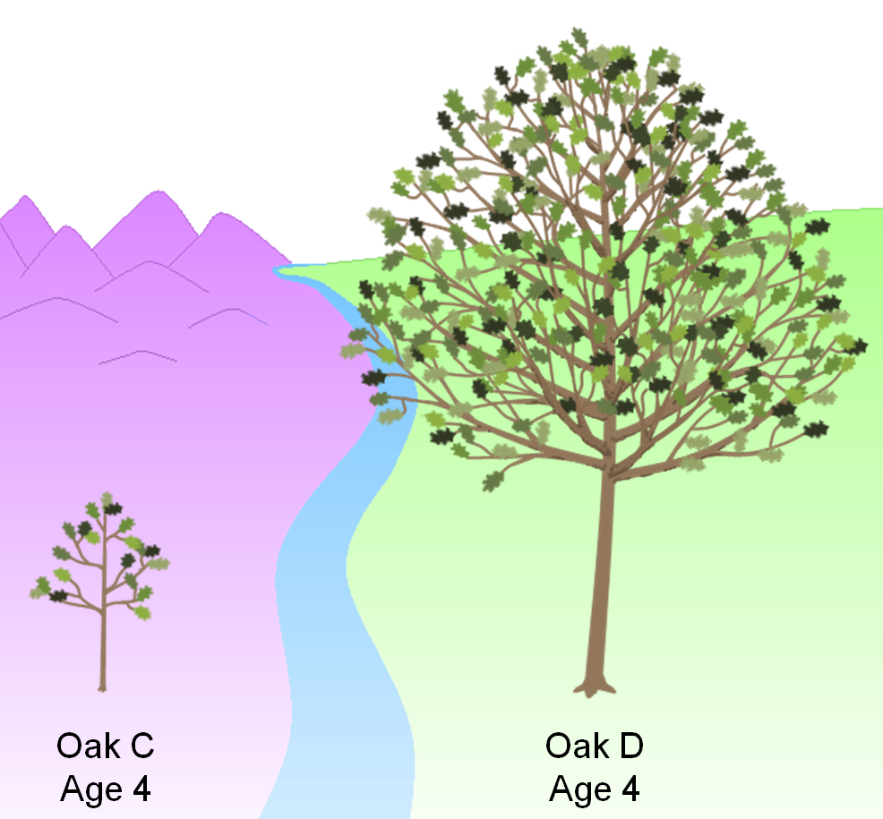
1. What about tall or short trees?
(High or low achieving students)

Slide 36
1. What about tall or short trees?
If we were using an Achievement Model, which gardener would you rather be?
How can we be fair to these gardeners in our Value-Added Model?
93 in.
Gardener C
Gardener D
28 in.
Oak C
Age 4
Oak D
Age 4
Notes:
In our analogy versus education context table, we mentioned prior tree height but did not go into details about this characteristic.
These two gardeners are about to care for these two trees for the next year.
If we were using an achievement model, which gardener would you rather be?
How can we be fair to these gardeners in our Value-Added model?

Slide 37
Why might short trees grow faster?
Why might tall trees grow faster?
More “room to grow”
Easier to have a “big impact”
Past pattern of growth will continue
Unmeasured environmental factors
How can we determine what is really happening?
Gardener C
Gardener D
Oak C
Age 4
Oak D
Age 4
Notes:
First of all, let’s think about whether tree height might have an effect on tree growth.
In general, why might short trees grow faster in the following year of gardener’s care?
Why might tall trees grow faster?
You can probably come up with some of your own guesses.
Some guesses we came up with for short trees are: shorter trees having more “room to grow” and that it might be easier for a gardener to have a “big impact” on the growth of that tree.
For tall trees, we guessed that tall trees have likely experienced a pattern of rapid growth in previous years, so this pattern might continue. In general, tall trees might be benefiting from some other environmental factor that we haven’t controlled for explicitly. This factor may benefit tall trees again next year.
These are all guesses about why gardeners with short trees or tall trees might be at an advantage. How can we determine what is really happening?

Slide 38
In the same way we measured the effect of rainfall, soil richness, and temperature, we can determine the effect of prior tree height on growth.
The Effect of Prior Tree Height on Growth
30 in
Growth from Year 4 to 5 (inches)
9 in
Oak C
(28 in)
Oak D
(93 in)
Prior Tree Height (Year 4 Height in Inches)
Notes:
In the same way we measured the effect of rainfall, soil richness, and temperature, we can determine the effect of prior tree height on growth.
We collect data on all Oak Trees in this specific region and measure whether short or tall trees grew faster.
In this case, we determine that tall trees tended to grow more.
In the earlier analogy, we assumed that all trees grew 20 inches during a year of care and then refined our predictions with each tree’s environmental conditions.
By including prior height in the model, we can improve our predictions by taking this data into account.
For example, before considering environmental conditions, Oak C with a starting height of 28 inches would be predicted to grow 9 inches. Oak D with a starting height of 93 inches would be predicted to grow 30 inches.

Slide 39
Our initial predictions now account for this trend in growth based on prior height.
The final predictions would also account for rainfall, soil richness, and temperature.
+30 in.
How can we accomplish this fairness factor in the education context?
+9 in.
Oak C
Age 4
Oak C
Age 5
(Prediction)
Oak D
Age 4
Oak D
Age 5
(Prediction)
Notes:
Our initial predictions now account for this trend in growth based on prior height.
The final predictions would also account for rainfall, soil richness, and temperature.
How can we accomplish this fairness factor in the education context?

Slide 40
Analyzing test score gain to be fair to teachers
df
Student | 3rd Grade Score | 4th Grade Score
Abbot, Tina | 244 | 279
Acosta, Lilly | 278 | 297
Adams, Daniel | 294 | 301
Adams, James | 275 | 290
Allen, Susan | 312 | 323
Alvarez, Jose | 301 | 313
Alvarez, Michelle | 256 | 285
Anderson, Chris | 259 | 277
Anderson, Laura | 304 | 317
Anderson, Steven | 288 | 308
Andrews, William | 238 | 271
Atkinson, Carol | 264 | 286
Test Score
Range
High
High
Achiever
Low
Low
Achiever
Notes:
Here we see 12 hypothetical students from a district.
For example,
Susan Allen scored very highly on her 3rd grade test, and highly again on her 4th grade test.
William Andrews had a very low score on both his 3rd grade and 4th grade tests.
A student’s skills and knowledge tend to persist from one year to the next. How can we use this information to make better predictions about student growth?

Slide 41
If we sort 3rd grade scores high to low, what do we notice about the students’ gain from test to test?
Student | 3rd Grade Score | 4th Grade Score | Gain in Score from 3rd to 4th
Allen, Susan | 312 | 323 | 11
Anderson, Laura | 304 | 317 | 13
Alvarez, Jose | 301 | 313 | 12
Adams, Daniel | 294 | 301 | 7
Anderson, Steven | 288 | 308 | 20
Acosta, Lilly | 278 | 297 | 19
Adams, James | 275 | 290 | 15
Atkinson, Carol | 264 | 286 | 22
Anderson, Chris | 259 | 277 | 18
Alvarez, Michelle | 256 | 285 | 29
Abbot, Tina | 244 | 279 | 35
Andrews, William | 238 | 271 | 33
Test Score
Range
High
Low
Notes:
If we sort 3rd grade scores high to low, what do we notice about students’ gain from test to test?
First we sort by each student’s 3rd Grade score.
We add a column that computes the gain in score from the 3rd grade to the 4th grade test.
For example, Susan Allen, our highest performing 3rd grader scored 312 on the 3rd grade test and 323 on the 4th grade test, a gain of 11 points.
William Andrews, our lowest performing 3rd grader scored 238 on the 3rd grade test and 271 on the 4th grade test, a gain of 33 points.
If we look at all this data together, do we notice a trend in the amount of gain students made based on their starting point on the 3rd grade test?

Slide 42
If we find a trend in score gain based on starting point, we control for it in the Value-Added model.
Student | 3rd Grade Score | 4th Grade Score | Gain in Score from 3rd to 4th
Allen, Susan | 312 | 323 | 11
Anderson, Laura | 304 | 317 | 13
Alvarez, Jose | 301 | 313 | 12
Adams, Daniel | 294 | 301 | 7
Anderson, Steven | 288 | 308 | 20
Acosta, Lilly | 278 | 297 | 19
Adams, James | 275 | 290 | 15
Atkinson, Carol | 264 | 286 | 22
Anderson, Chris | 259 | 277 | 18
Alvarez, Michelle | 256 | 285 | 29
Abbot, Tina | 244 | 279 | 35
Andrews, William | 238 | 271 | 33
Test Score
Range
High
Low
Gain
High
Low
Notes:
If we find a trend in score gain based on starting point, we control for it in the Value-Added model.
In this case, we see a trend that students with high scores in 3rd grade tended to gain fewer points on the 4th grade test.
Students with low score in 3rd grade tended to gain more points on 4th grade test.
Please note that this is a small subsection of students from multiple schools across the district or state. To make these kind of analyses, we use data from all students in the district or state to detect trends and patterns.
If we found that this pattern continued across an entire district or state, we would come to the conclusion that during this time period, students with low 3rd grade scores were more likely to gain more points on the 4th grade test than students starting off with high 3rd grade scores.
This is typically what we find when analyzing real test data. Higher achieving students tend to gain fewer points during a year of growth.
By measuring this trend and controlling for it when we make predictions, Value-Added Estimates can fairly compare the growth of students from across the achievement spectrum.

Slide 43
What do we usually find in reality?
Looking purely at a simple growth model, high achieving students tend to gain about 10% fewer points on the test than low achieving students.
In a Value-Added model we can take this into account in our predictions for your students, so their growth will be compared to similarly achieving students.
Notes:
Presenter notes:
Reasons this may be the case:
If student knowledge is not totally durable (learning is subject to decay would lead to lambda less than 1)
If school resources are allocated differently based on prior achievement (lambda less than 1 if more resources allocated to lower achievers, lambda greater than 1 if more resources allocated to higher achievers)
Different test scales used in pretest and posttest (lambda would partially reflect differences in scale)
If the relationship between post and prior achievement is nonlinear due to different methods used to scale assessments
From Meyer / Dokumaci Paper:
The model would be
simpler to estimate if it were appropriate to impose the parameter restriction λ =1, but there are at
least four factors that could make this restriction invalid. First, λ could be less than 1 if the stock of
knowledge, skill, and achievement captured by student assessments is not totally durable, but rather is
subject to decay. Second, λ could differ from 1 if school resources are allocated differentially to
students as a function of prior achievement. If resources were to be tilted relatively toward low achieving
students—a remediation strategy—then λ would be reduced. The opposite would be true if
resources were tilted toward high‐achieving students. Third, λ could differ from1 if posttest and pretest
scores are measured on different scales, perhaps because the assessments administered in different
grades are from different vendors and scored on different test scales or due to instability in the
variability of test scores across grades and years. In this case, the coefficient on prior achievement
partially reflects the difference in scale units between the pretest and posttest. Fourth, the different
methods used to scale assessments could in effect transform posttest and pretest scores so that the
relationship between post and prior achievement would be nonlinear. In this case a linear value‐added
model might still provide a reasonably accurate approximation of the achievement growth process, but
the coefficient on prior achievement (as in the case of the third point) would be affected by the test
scaling.

Slide 44
Comparisons of gain at different schools before controlling for prior performance
School A
School B
School C
Student
Population
Advanced
Proficient
Basic
Minimal
High
Achievement
Medium
Achievement
Low
Achievement
Why isn’t this fair?
Artificially lower gain
Artificially inflated gain
Notes:
Here we see three schools serving different student populations.
For example,
School A is serving mostly students with very high test scores.
On the other extreme, School C is serving mostly students with very low test scores.
Keep in mind what we just saw in the previous slide about district-wide or state-wide trends in gain on the test.
Why would it be unfair to compare of test score gain at different schools before controlling for prior performance?
In the previous slides, we saw that in this example test, students higher on the test scale tended to gain fewer points on average across the district.
If in reality School A, School B, and School C were all average at helping students learn, School C would look the best in a simple growth or gain model and School A would look the worst.
On average, students in the Minimal category would gain more points due to the uneven test scale we observed on the previous slide. That would make School C’s gains artificially inflated.
On average, students in the Advanced category would gain fewer points due to the uneven test scale. That would make School A’s gains artificially lower.

Slide 45
Comparisons of Value-Added at different schools after controlling for prior performance
School A
School B
School C
Student
Population
Advanced
Proficient
Basic
Minimal
Fair
Fair
Fair
Notes:
Since VARC analyzes the trend of scores for all student in the district or state, we can analyze these trends and determine the appropriate adjustments to counteract these effects in our predictions.
After we have made these customized predictions, we can fairly evaluate the growth of students in schools serving students with any achievement level distribution.
High Achieving students in School A are compared to typical growth for similar high achieving students from across the district or state.
Low Achieving students in School C are compared to typical growth for similar low achieving students from across the district or state.

Slide 46
Checking for Understanding
What would you tell a teacher or principal who said Value-Added was not fair to schools with:
High-achieving students?
Low-achieving students?
Is Value-Added incompatible with the notion of high expectations for all students?
Notes:
VARC-suggested answers:
What would you tell a teacher or principal who said Value-Added was not fair to schools with:
High achieving students?
Low achieving students?
The answer in both these cases is that Value-Added estimates take into account the starting point of students. The growth of your students is compared to the growth of similarly achieving students from across the district or state.
If it turns out that high-achieving students grow at a slower rate than low-achieving students across the state, then the amount of predicted growth for your students will be adjusted to compensate.
Is Value-Added incompatible with the notion of high expectations for all students?
One key point to make here is what is the purpose of a measure and what are we evaluating.
In the Oak Tree Analogy, we are not evaluating oak trees. We are evaluating the gardeners.
It seems to follow that in order to fairly evaluate the gardeners, it’s logical to take into consideration the effect of external factors. This is not a goal-setting exercise for the trees. It’s a way to measure the impact of the gardeners in a fair way.
In this section, the gardeners could both aspire to have towering 100” oak trees at the end of the year even though they started at 28” and 93”.
Our goal to get all trees to 100” by age 5, but we know this would put the gardener with a 28” tree at a disadvantage for their effectiveness rating.
In the same way in education, we can have high expectations for all our students but realize that holding teachers accountable by the same standard creates bias in their evaluations of effectiveness.

Slide 47
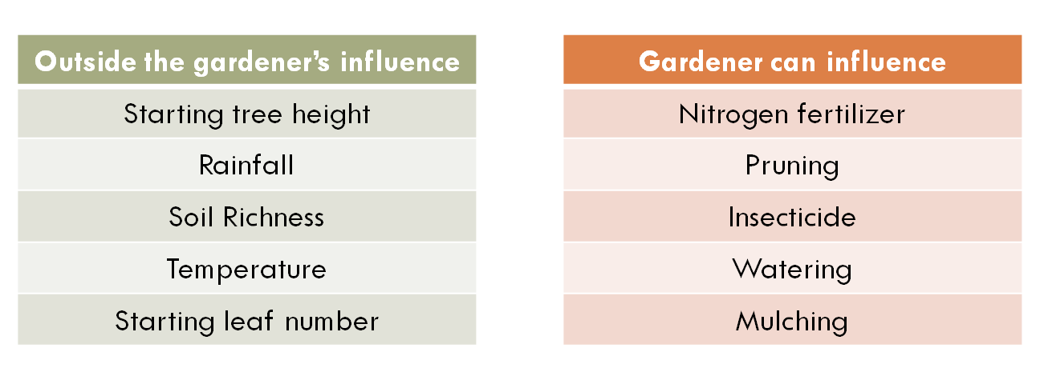
2. How does VARC choose what to control for?
(Proxy measures for causal factors)

Slide 48
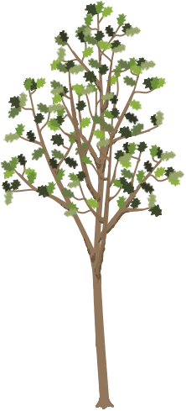
2. How does VARC choose what to control for?
Imagine we want to evaluate another pair of gardeners and we notice that there is something else different about their trees that we have not controlled for in the model.
In this example, Oak F has many more leaves than Oak E.
Is this something we could account for in our predictions?
73 in.
73 in.
Gardener E
Gardener F
Oak E
Age 5
Oak F
Age 5
Notes:
Imagine we want to evaluate another pair of gardeners and we notice that there is something else different about their trees that we have not controlled for in the model.
In this example, Oak F has many more leaves than Oak E.
Is this something we could account for in our predictions?

Slide 49
In order to be considered for inclusion in the Value-Added model, a characteristic must meet several requirements:
Check 1: Is this factor outside the gardener’s influence?
Check 2: Do we have reliable data?
Check 3: If not, can we pick up the effect by proxy?
Check 4: Does it increase the predictive power of the model?
Notes:
In order to be considered for inclusion in the Value-Added model, a characteristic must meet several requirements:
Check 1: Is this factor outside the gardener’s influence?
Check 2: Do we have reliable data?
Check 3: Can we approximate it with other data?
Check 4: Does it increase the predictive power of the model?

Slide 50
Check 1: Is this factor outside the gardener’s influence?
Outside the gardener’s influence
Starting tree height
Rainfall
Soil Richness
Temperature
Starting leaf number
Gardener can influence
Nitrogen fertilizer
Pruning
Insecticide
Watering
Mulching
Notes:
Check 1: Is this factor outside the gardener’s influence?
Here are some examples of categorized factors.
In a Value-Added model, we could potentially control for items in the green box.
Since the gardener could influence items in the red box, we would NOT want to control for them in the Value-Added model.

Slide 51
Check 2: Do we have reliable data?
Category | Measurement | Coverage
Yearly record of tree height | Height (Inches) | 100%
Rainfall | Rainfall (Inches) | 98%
Soil Richness | Plant Nutrients (PPM) | 96%
Temperature | Average Temperature (Degrees Celsius) | 100%
Starting leaf number | Individual Leaf Count | 7%
Canopy diameter | Diameter (Inches) | 97%
Notes:
Check 2: Do we have reliable data?
In 7% of cases, actual leaf number was recorded for trees. This is not enough to include this data in the Value-Added model.

Slide 52
Check 3: Can we approximate it with other data?
Category | Measurement | Coverage
Yearly record of tree height | Height (Inches) | 100%
Rainfall | Rainfall (Inches) | 98%
Soil Richness | Plant Nutrients (PPM) | 96%
Temperature | Average Temperature (Degrees Celsius) | 100%
Starting leaf number | Individual Leaf Count | 7%
Canopy diameter | Diameter (Inches) | 97%
?
Notes:
Check 3: Can we approximate it with other data?
It may be the case that canopy diameter could be used as a proxy for the real data we desire.

Slide 53
Canopy diameter as a proxy for leaf count
The data we do have available about canopy diameter might help us measure the effect of leaf number.
The canopy diameter might also be picking up other factors that may influence tree growth.
We will check its relationship to growth to determine if it is a candidate for inclusion in the model.
Gardener E
Gardener F
33 in.
55 in.
Oak E
Age 5
Oak F
Age 5
Notes:
The data we do have available about canopy diameter might help us measure the effect of leaf number.
Check 4 involves increasing the predictive power to the model.

Slide 54
If we find a relationship between starting tree diameter and growth, we would want to control for starting diameter in the Value-Added model.
The Effect of Tree Diameter on Growth
?
Growth from Year 5 to 6 (inches)
Tree Diameter (Year 5 Diameter in Inches)
Notes:
If we find a relationship between starting diameter and growth, we would want to control for starting diameter in the Value-Added model.
We might find that on its own, tree diameter does not have a clear effect on growth.

Slide 55
If we find a relationship between starting tree diameter and growth, we would want to control for starting diameter in the Value-Added model.
The Effect of Tree Diameter on Growth
Growth from Year 5 to 6 (inches)
Tree Diameter (Year 5 Diameter in Inches)
Notes:
We might find that tree diameter has a strong effect on growth.
If so, we would want to include starting tree diameter in our predictions to be fair to the gardeners.

Slide 56
What happens in the education context?
Check 1: Is this factor outside the school or teacher’s influence?
Check 2: Do we have reliable data?
Check 3: If not, can we pick up the effect by proxy?
Check 4: Does it increase the predictive power of the model?
Notes:
In order to be considered for inclusion in the Value-Added model, a characteristic must meet several requirements:
Check 1: Is this factor outside the gardener’s influence?
Check 2: Do we have reliable data?
Check 3: Can we approximate it with other data?
Check 4: Does it increase the predictive power of the model?

Slide 57
Check 1: Is this factor outside the school or teacher’s influence?
Outside the school’s influence
At home support
English language learner status
Gender
Household financial resources
Learning disability
Prior knowledge
School can influence
Curriculum
Classroom teacher
School culture
Math pull-out program at school
Structure of lessons in school
Safety at the school
Let’s use “Household financial resources” as an example
Notes:
Check 1: Is this factor outside the gardener’s influence?
Here are some examples of categorized factors.
In a Value-Added model, we could potentially control for items in the green box.
Since the school or teacher could influence items in the red box, we would NOT want to control for them in the Value-Added model.

Slide 58
Check 2: Do we have reliable data?
What we want
Household financial resources
Notes:
One example of a non-school factor we want to control for is household financial resources.
Ideally for our calculations, we would have a comprehensive list of resources available for each student.

Slide 59
Check 3: Can we approximate it with other data?
What we want
Household financial resources
What we have
Free / reduced lunch status
Related data
Using your knowledge of student learning, why might
“household financial resources” have an effect on student growth?
Check 4: “Does it increase the predictive power of the model?” will be determined by a multivariate linear regression model based on real data from your district or state (not pictured) to determine whether FRL status had an effect on student growth.
Notes:
Since that data is not available, we use what we do have as a substitute for our ideal data.
In most districts and states, we use eligibility for free and reduced lunch status.
This does not give us a complete picture of the financial resources available at a student’s household, but it is related data and is the best approximation we have available on the topic.
Using your knowledge of student learning, why might “household financial resources” have an effect on student growth?
Reasons we have heard from educators include:
Different access to technology, such as computers at home
Different likelihood to have external help available, such as paid tutoring services
Possible difference in parental availability for homework and study help due to multiple jobs
You can probably think of other reasons why household financial resources might affect student growth. Since these reasons are not something the school is responsible for, we want to remove the influence of this factor as best we can in order to fairly evaluate schools serving different student populations.
Check 4 would be based on a multivariate linear regression model to determine whether FRL status had an effect on student growth in your district or state.
If we find a district-wide or state-wide difference in growth trend based on financial resources, we can customized our predicted outcomes for students based on this characteristic.
LIVE PRESENTER NOTES:
Some possible talking points on the question:
Doug Harris’s book points (summer learning loss, etc.)
From Doug Harris Book:
“Should value-added models take into account student race,
income, and other student factors in estimating value-added?
This is one of the more controversial questions in using value-added for
accountability. In one respect, the issue boils down to whether taking
into account prior achievement is enough. Race, ethnicity, and
income are after all closely related to student attainment on test scores
(see Figure 1.1). But it turns out that these factors are less closely
related to achievement growth.
The reason for this should be intuitive: if student demographics
are associated with achievement in every grade, then the association
should largely “cancel out” when subtracting the two. Here is a
simple, concrete example to highlight this: Suppose that a student
scored 60 points in one year and 80 points in the next year and grade,
for growth of 20 points. Now, suppose that part of the reason
explaining these scores is that fact that the students’ parents do not
make sure the child does her homework each night (in all years). This
might reduce the student’s score by 5 points in each year from what it
would have been. So, the student would have scored 65 and 85
(instead of 60 and 8) if the student had done her homework. Notice
that the growth is exactly the same in both cases—20 points. So long
as the influence on student scores is constant over time, the influence
on scores should cancel out in this way.
But minority and low-income students do still learn at slower
rates. One study finds that while most of the gap by family income
exists in 1st grade, it grows by about 30 percent between 1st and 5th
grade.1 Almost all of this, in turn is due, not to what happens in
school, but to the “summer learning loss,” the period between school
years when students are not in school. This is most likely because
the same factors creating the starting gate inequalities also affect
learning growth. Because standardized tests are not administered at
the beginning of the school year, the summer learning loss is
embedded within the student growth measures. Further, the summer
learning loss is substantially outside the control of schools and
therefore problematic. An accurate measure of value-added must take
into account all of the factors outside their control.
The concern with accounting for race and income, however, is
that some see it as reducing expectations for these students. There
are legitimate differences of opinion on this point, but let me clarify
the two different meanings of “lower expectations.” On the one hand,
this could mean that accounting for race and income means that
schools can get by giving less effort to raise achievement for
disadvantaged students. Value-added measures that account for race
and income do not lower expectations in this sense. In fact, the whole
point of value-added is to create an even playing field and one that
provides incentives for schools to help all students.
Alternatively, some interpret “lower expectations” to mean that
schools serving disadvantaged students will have the same measured
performance as schools serving advantaged students while generating
less student learning. If this is what is meant by lower expectations,
then it is a legitimate point. Value-added models that adjust
predictions based on student race and income do require less learning
of disadvantaged students to reach the same level of school
performance. Again, this just reflects the fact that schools should not
be held accountable for factors outside their control and students’
home environments and other factors affecting students clearly fall
into that category.
There is some potential middle ground on this issue. If the
concern is about how much emphasis schools place on achievement of
different groups, value-added measures can be designed to place as
much or as little weight on disadvantaged students as we wish. For
example, we could design the accountability system so that 10 points
in growth for a low-income student counts twice as much as for a
high-income student. Also, when statisticians estimate value-added,
they also end up estimating the statistical relationship (correlation)
between student race and income and student achievement growth
(see Oakville example above). Districts could use the measured role of
student disadvantage as an indicator of how well the district is doing
to overcome racial and income achievement gaps.2 If socio-economic
disadvantage is associated with lower growth, then this might
motivate districts to try even harder to address the issue. That is,
rather than lowering expectations, it can be a driver of higher
expectations and even greater effort for those students.
It is also worth recalling that value-added measures can help
reduce the problem of driving out teachers of low-attainment schools.
The same goes for disadvantaged students. To the degree that
student race and income are associated with their achievement
growth, failing to account for those factors will place the teachers of
those students at a disadvantage.
In my view, it is best to account for student race and income
when predicting each school’s achievement. The reason comes back
to the Cardinal Rule: Hold people accountable for what they can
control. While this means that schools serving disadvantaged
students will receive higher performance ratings with less growth, it
does not mean that schools can get by with giving less effort to these
students. If, in addition, we give disproportionate weight to the
growth of racial minorities and low-income students, and use the
statistical relationship between student disadvantage and student
achievement growth as a motivation to address the gap, then
accounting for student disadvantage would seems to raise
expectations—and outcomes—for these students rather than lower
them. I cannot prove that, unfortunately, but there is a strong
rationale behind it.”

Slide 60
What about race/ethnicity?
Race/ethnicity causes higher or lower performance
What we want
General socio-economic status
Family structure
Family education
Social capital
Environmental stress
What we have
Race/ethnicity
Related complementary data may correlate with one another
(not a causal relationship)
Check 4 will use real data from your district or state to determine if race/ethnicity has an effect on student growth.
If there is no effect, we decide with our partners whether to leave it in.
Notes:
What about race and ethnicity?
One of the pieces of data often collected is student race and ethnicity.
Why might we include this in the model?
Rather than a causal relationship between race and student growth, it might be the case that race/ethnicity is picking up the effect of factors like general socio-economic status, family structure, family education, social capital, and environmental stress.
This will not always be the case for every student, but it may be true across entire districts or states.
During check 4, VARC uses real data from your district or state to determine if race/ethnicity has an effect on student growth.
If there is no effect, we decide with our partners whether to leave it in.

Slide 61
What about race/ethnicity?
If there is a detectable difference in growth rates
We attribute this to a district or state challenge to be addressed
When a teacher generates higher growth than other teachers serving similar students, it is accurate and fair to identify him/her as a high performing teacher.
Notes:
If there is a detectable difference in growth rates of different groups of students, we attribute this to a district or state challenge to be addressed, not something an individual teacher or school should be expected to overcome on their own. If a particular school, grade-level team, or teacher is making above-average results with any group of students, this will be reflected in an above-average Value-Added estimate.
By using all the data we have available, we try to get the most complete picture of the real situations of students to make our predictions as accurate as possible. The more complete job VARC can do at controlling for external factors, the more accurate we can be about evaluating the effect of districts, schools, grades, classrooms, programs, and interventions.

Slide 62
Checking for Understanding
What would you tell a 5th grade teacher who said they wanted to include the following in the Value-Added model for their results?:
5th grade reading curriculum
Their students’ attendance during 5th grade
Their students’ prior attendance during 4th grade
Student motivation
Check 1: Is this factor outside the school or teacher’s influence?
Check 2: Do we have reliable data?
Check 3: If not, can we pick up the effect by proxy?
Check 4: Does it increase the predictive power of the model?
Notes:
VARC suggested answers:
A. 5th grade reading curriculum fails at “check 1”. A school or teachers could have an influence on the curriculum that’s chosen and the implementation of the curriculum. This would be like fertilizer in the gardener analogy. It’s one of the strategies employed to try to get a desired result. We don’t want to control for this in the model, since the effect of this and other strategies is what we’re trying to measure and isolate with our outcome.
B. Can a really engaging teacher get his or her students to come to school more often? Maybe. This could potentially fail at “check 1” since the teacher may be able to influence this outcome.
C. Can a 5th grade teacher get students to come to school more often one year in the past? No. This is our chance to try to pick up the effect of attendance. It passes “check 1”, so let’s go to “check 2”. Do we have reliable data?
The answer to this part varies by district or state. If we do have reliable attendance data, we’d continue to “check 4” to determine if it increases the predictive power of the model.
(For more information on the difference between B and C, please see the explanation below… after D)
D. Does a teacher have control over student motivation? It probably depends on how we define “motivation”. If we decide whether it passes “check 1”, we move on to “check 2” and “check 3” to see if we have data on it or can pick it up by proxy. Most likely the answers to both of these is “no”.
It’s important to note here that this is an example of something we would like to control for, but we do not have the data to do so.
Value-Added is not a perfect measure, but it is the best we’re able to do with the existing data. VARC’s model is continually improving as we make statistical innovations and new student data becomes available. Our hope is that over time, our models become better and better at fairly measuring educator effectiveness.
Consider the next section for why it’s reasonable to consider Value-Added measures as useful even when we don’t have the whole picture (including student motivation and other unmeasured characteristics)
More information on attendance (taken from VARC’s answer to “How does the model account for student attendance” in the LAUSD FAQ)
In LAUSD, Value-Added is called “AGT”
How does the model account for student attendance?
Attendance is not included in the AGT model. LAUSD's data systems do not currently have enough information to produce a reliable AGT dosage model based on attendance data. LAUSD is working to improve the data system so future analysis years will take this data into account.
When reliable data is available, the AGT model will account for prior attendance rather than attendance for the year being measured by AGT.
Why would we account for prior attendance rather than current attendance? As with other variables controlled for in the AGT model, we want to remove the effect of factors beyond the school’s or teacher’s control. When a student is assigned to a teacher, there may be strategies the teacher can use to get a previously low-attending student to come to class more often (strong parent interactions, engaging classroom activities, encouraging classroom community building, etc.) On the other hand, this particular teacher does not have any control over the attendance history of that student from previous years (before they entered this teacher’s classroom).
Let’s assume that across the district, our analysis found that students with lower attendance grew less than students with higher attendance.
In the following example, we will consider that there are two 7th grade math teachers. These two teachers have been assigned two groups of students who have exactly the same characteristics, including a low average attendance rate (75%) from last year.
During the past year, teacher A used strategies in her classroom that resulted in her students having a much higher attendance rate than these students had last year. The average attendance rate for her students was 90% instead of 75%.
In teacher B’s classroom, there were no strategies used to increase student attendance, and her students actually had a much lower attendance rate than they had last year. The average attendance rater for her students was 60% instead of 75%.
With the situation above, let’s explore the results we would get with an AGT model that controlled for current attendance vs. prior attendance.
In an AGT model, student growth for a given teacher’s classroom is compared to the predicted growth of those students. This prediction is based on the average growth of similar students (accounting for prior test performance and student characteristics) across LAUSD during the same time period.
If AGT controlled for current attendance in the above scenario:
Teacher A’s prediction for growth of her students would be based on students across the district who also had 90% attendance rate. Since we assumed the probable outcome that students with higher attendance rates learn more during the school year, teacher A’s predicted growth would be higher since her students came to school more often than they did in the past.
In the case of teacher B, her prediction for the growth of her students would be based on students across the district that also had 60% attendance rate. Teacher B’s predicted growth would be lower since her students came to the school less often than they did in the past.
In this case, teacher A (who managed to get incredible attendance for her students) is held to a higher prediction than teacher B (who ended up with much lower attendance for her students). This would set up an incentive structure where teachers would be more likely to get high AGT if their students had lower attendance. We want higher attendance for our students, so AGT should not be set up this way.
On the other hand, if AGT controlled for prior attendance in the above scenario:
Teacher A and teacher B would have exactly the same predicted growth for their students. Their predicted performance would be based on the growth of similar students across the district that had the same 75% attendance rate for the previous year.
Teacher A, with her higher attendance rate, would be more likely to have a higher AGT result with that increased instruction time in the classroom. Teacher B, with her low attendance rate, would be more likely to have a lower AGT result with less instructional time in the classroom.
This matches our intended incentive structure, where teacher who use strategies to get historically low attending students to come to school get recognition for this results in their student growth.

Slide 63
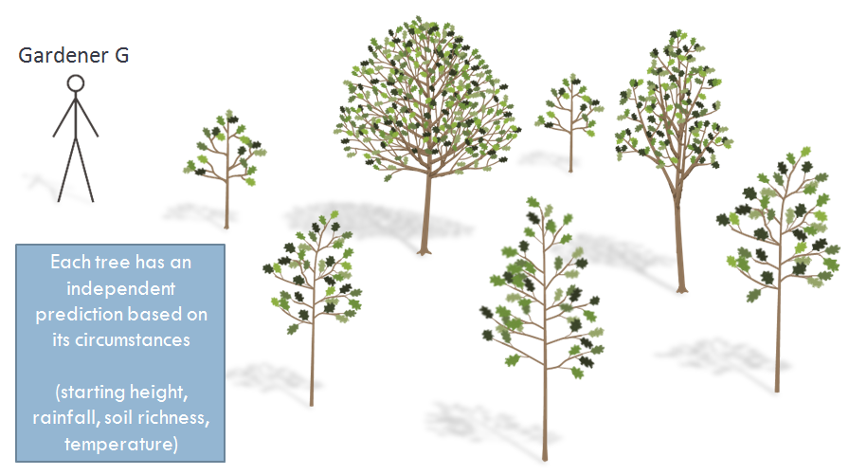
3. What if a gardener just gets lucky or unlucky?
(Groups of students and confidence intervals)

Slide 64
3. What if a gardener just gets lucky or unlucky?
Gardener G
Oak A predicted growth:
10 inches
Oak A
Age 3
(1 year ago)
Predicted
Oak A
Notes:
What if a gardener just gets lucky or unlucky?
Based on all available data for Oak A, we predict that by the end of the year, Oak A will grow 10 inches.

Slide 65
Gardener G
Oak A actual growth:
2 inches
For an individual tree, our predictions do not account for random events.
Oak A
Age 3
(1 year ago)
Actual
Oak A
Notes:
But there are limits to what our predictions can tell us.
For an individual tree, our predictions do not account for random events.

Slide 66
Gardeners are assigned to many trees
Gardener G
Each tree has an independent prediction based on its circumstances
(starting height, rainfall, soil richness, temperature)
Notes:
In the oak tree analogy, we have been considering a single tree for each gardener.
To be a more accurate portrayal of how Value-Added works, gardeners would be assigned to many trees.
Each of the gardener’s trees has an independent set of circumstances (prior height, rainfall, etc.), so the prediction for each tree will be customized for its own situation.

Slide 67
How confident would you be about the effect of these gardeners?
Gardener G
Total trees assigned
5
Trees that missed predicted growth
3
Trees that beat predicted growth
2
Due to unlucky year
2
Due to gardener
1
Due to gardener
2
Due to lucky year
0
Gardener H
Total trees assigned
50
Trees that missed predicted growth
30
Trees that beat predicted growth
20
Due to unlucky year
7
Due to gardener
23
Due to gardener
15
Due to lucky year
5
Notes:
A Value-Added estimate represents the average effect of the gardener on this group of assigned trees.
Since individual trees could have a lucky or unlucky year, the more trees a gardener is assigned to, the more sure we can be about the effect of the gardener.

Slide 68
Reporting Value-Added
In the latest generation of Value-Added reports, estimates are color coded based on statistical significance. This represents how confident we are about the effect of schools and teachers on student academic growth.
Green and Blue results are areas of relative strength.
Student growth is above average.
Gray results are on track. In these areas, there was not enough data available to differentiate this result from average.
Yellow and Red results are areas of relative weakness.
Student growth is below average.

Slide 69
3
Numbers lower than 3.0 represent growth that did not meet prediction.
Students are still learning, but at a rate slower than predicted.
3.0 represents meeting predicted growth for your students.
Since predictions are based on the actual performance of students in your district or state, 3.0 also represents the district or state average growth for students similar to yours.
Numbers higher than 3.0 represent growth that beat prediction.
Students are learning at a rate faster than predicted.
Value-Added is displayed on a
1-5 scale for reporting purposes.
About 95% of estimates will fall between 1 and 5 on the scale.
Grade 4
30

Slide 70
3
READING
Grade 4
30
3.8
95% Confidence Interval
Value-Added estimates are provided with a confidence interval.
Based on the data available for these thirty 4th Grade Reading students, we are 95% confident that the true Value-Added lies between the endpoints of this confidence interval (between 3.2 and 4.4 in this example), with the most likely estimate being 3.8.

Slide 71
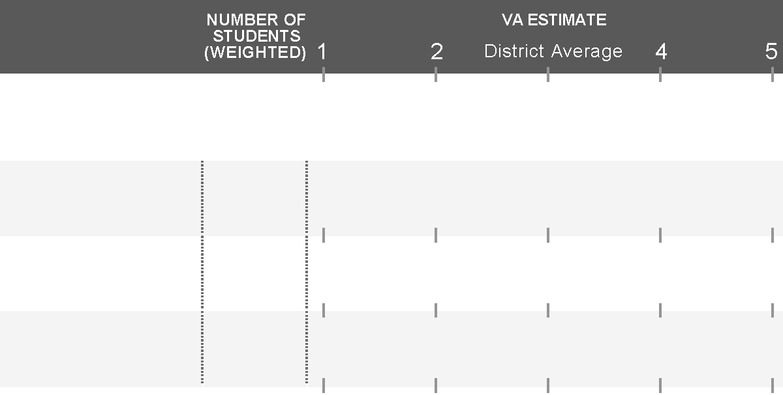
Confidence Intervals
Color coding is based on the location of the confidence interval.
The more student data available for analysis, the more confident we can be that growth trends were caused by the teacher or school (rather than random events).
3
READING
Grade 3
13
4.5
Grade 4
36
4.5
Grade 5
84
4.5
3
MATH
Grade 3
13
1.5
Grade 4
36
1.5
Grade 5
84
1.5

Slide 72
Checking for Understanding
A teacher comes to you with their Value-Added report wondering why it’s not a green or blue result.
She wants to know why there’s a confidence interval at all when VARC had data from each and every one of her students. (Don’t we know exactly how much they grew?)
3
READING
Grade 7
11
4.2
Notes:
VARC suggested answers:
The estimate has a wide confidence interval due to only 11 students in this estimate. These students grew at a rate above average for their observationally similar peers (as signified by the “4.2” point estimate), but there were too few students to be able to infer that this outcome was due to the effect of the educators involved (rather than random events or statistical noise). The long confidence interval crosses “3”, so we color code our estimate gray.
We know the scores of all these students, but Value-Added is not simply a report of how many points students grew on the test. We’re combining data from multiple sources (student test data measured with error since no test is perfect, and demographic data) from a limited number of students to try to find the true effectiveness of this educator. Imagine a scenario where there was only a single student in a classroom. Is it fair to judge the teacher’s true teaching ability based on the outcome of this single student? If we were able to observe the impact of a teacher on dozens or hundreds of students over the years, we would be more confident of the teacher’s impact on those students. With Value-Added we’re inferring this true ability by analyzing the outcomes of a relatively small number of students. The more students a teacher teaches over a period of time, the stronger our conclusions can be about the true effectiveness of the teacher. We represent how confident we are with the statistical confidence interval around our best estimate.

Slide 73
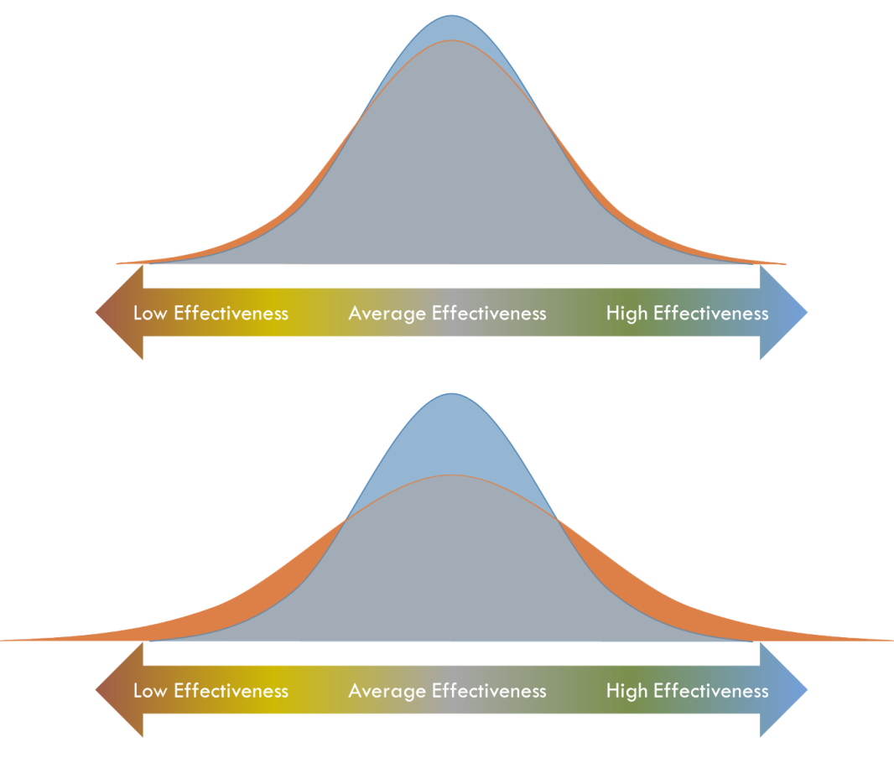
4. Are Some Gardeners More Likely to Get Lucky or Unlucky?
(Statistical Shrinkage)

Slide 74
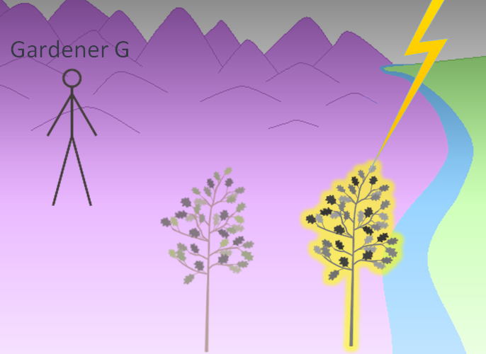
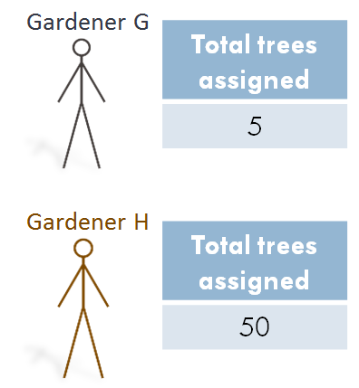
The Previous “Unlucky Gardener” Example
Our example gardener had low growth for a tree due to an unforeseen factor.
We use confidence intervals to show how confident we are that growth is due to the gardeners.
More assigned trees means tighter confidence intervals.
Notes:
In our last “Oak Tree Analogy Expansion”, the best we came up with was the inclusion of confidence intervals.
Since we know there are unrecorded / unknown events that can influence the growth of trees (or students), we use confidence intervals around estimates.
We are trying to isolate the effect of the gardener (or teacher) on growth, so the more data that is available, the more statistically confident we can be that the observed outcome (high or low growth) is due to something the gardener (or teacher) is doing rather than random events.

Slide 75
Can We Improve Our Estimates?
Unfair low measured growth due to “unlucky” factors
More accurate measurement of true contribution to growth
Unfair high measured growth due to “lucky” factors
Notes:
What follows from this, it that gardeners with fewer trees have wider confidence intervals.
Gardeners with many trees have narrower confidence intervals.
With fewer data points, gardeners with fewer trees tends to have more “unlucky” years where their estimates are unusually low.
Gardeners with many trees are more likely to get a fair evaluation of their contribution to tree growth.

Slide 76
Gardener Effectiveness
Imagine we were able to measure definitively the true effectiveness of every gardener.
We might expect to find most gardeners close to average with fewer as we get to the extremes.
Low Effectiveness Average Effectiveness High Effectiveness
Notes:
Regardless of the number of trees to which a gardener is assigned, we might assume that there are more “average” gardeners with fewer that are truly far above or far below average.

Slide 77
A Bell Curve of Effectiveness
We can imagine this true distribution of gardener effectiveness as a bell curve.
True Variance of Gardener Effects
Low Effectiveness Average Effectiveness High Effectiveness
Notes:
We can represent this distribution of gardener effectiveness as a bell curve.
Note that this is a distribution of gardener effectiveness, not of the number of trees to which gardeners are assigned.

Slide 78
A Bell Curve of Effectiveness
What happens when we add in “lucky” and “unlucky” factors (statistical estimation error)?
True Variance of Gardener Effects
Variance Including Estimation Error
Gardeners with low growth due to “unlucky” factors
Gardeners with high growth due to “lucky” factors
Low Effectiveness Average Effectiveness High Effectiveness
Notes:
The blue curve represents the true effectiveness of our gardeners.
Ideally, our Value-Added output would match this true distribution of gardener effectiveness.
However, we know our model is missing some uncaptured “lucky” and “unlucky” events.
The effect of these uncaptured factors is that the distribution coming out of our basic Value-Added model is flatter and wider than the true distribution.
Estimation error adds variance to the curve, which leaves these “orange gardeners” with Value-Added estimates that are too low due to “unlucky” factors or too high due to “lucky” factors.

Slide 79
The Effect of Estimation Error Increases with Fewer Data Points
Gardeners with 50 trees
Gardeners with 5 trees
Solution: Shrinkage Estimation
Low Effectiveness Average Effectiveness High Effectiveness
True Variance of Gardener Effects
Variance Including Estimation Error
Low Effectiveness Average Effectiveness High Effectiveness
Notes:
Fitting our intuition about how “lucky” and “unlucky” events bias our estimates, estimation error affects gardeners with fewer trees more than gardeners with more trees.
In this example, we have selected a group of many gardeners each with 50 trees in the top distribution and a group of many gardeners each with 5 trees in the bottom distribution.
Note that the blue curves representing the true effectiveness of each group of gardeners are the same.
That is, if there was no estimation error, we would determine that there are the same proportion of low, average, and highly effective gardeners in either group.
However, when we add in the effect of estimation error, we see that in both groups, the new orange curve is lower and wider than the true blue distribution.
The effect is greater in the group of gardeners with only 5 trees, since “lucky” or “unlucky” events have a greater relative impact.
The solution to this problem is statistical shrinkage estimation.
By adding in this step in the model, VARC can counteract the effect of estimation error to shrink the orange distribution back to the shape of the true blue distribution.
Shrinkage has a stronger effect for our 5-tree group than the 50-tree group.

Slide 80
Why Use Statistical Shrinkage Estimation in the Education Context?
Without shrinkage, small schools and classrooms would be falsely overrepresented in the highest and lowest Value-Added categories.
Shrinkage improves the accuracy and precision of Value-Added estimates by adjusting for the wider variance that occurs simply as a result of teaching fewer students.
Shrinkage increases the stability of Value-Added estimates from year to year.

Slide 81
The Effect of Statistical Shrinkage on a Value-Added Report
NUMBER OF
STUDENTS
(WEIGHTED)
VALUE-ADDED ESTIMATES
1
2
3
4
5
MATH
Grade 3
20.0
1.7
2.4
Grade 4
40.0
3.8
4.3
Grade 5
60.0
1.6
1.9
Before Shrinkage
After Shrinkage

Slide 82
The Estimates on Your Report Already Include Statistical Shrinkage
Estimates always moved closer to “average”
Estimates were shrunk less when:
There were many students
The original (unshrunk) estimate was close to average
Shrinkage is the reason simple “weighted averages” of Value-Added estimates do not match our reported aggregate numbers
Example: an Elementary School’s overall math is not simply the weighted average of each grade-level math estimate
Notes:
Might be more helpful to expand on the last point

Slide 83
Checking for Understanding
NUMBER OF
STUDENTS
(WEIGHTED)
VALUE-ADDED ESTIMATES
Using what you now know about shrinkage estimation, explain how it is possible for this elementary school’s overall average Value-Added to be reported lower than any of the individual grade-level estimates.
1
2
3
4
5
READING
School-Level Value-Added
Overall
300
1.5
MATH
READING
Grade-Level Value-Added
Grade 3
100
2.1
Grade 4
100
2.3
Grade 5
100
1.9
Notes:
In a case like this, intuition would tell us that the overall average for a school’s Value-Added estimate would be a weighted average of the three individual grade-level estimates.
In this case, the weighted average would put the school overall average at 2.1
(2.1 + 2.3 + 1.9)/3 =2.1
However, we can see that the overall average is 1.5
The missing part of the puzzle here is shrinkage.
One of the things we know about shrinkage is that the fewer students there are, the more a Value-Added estimate is shrunk to account for the possibility of random “lucky” or “unlucky” factors making an estimate very low or high.
Using the information in this school’s scenario, what likely happened was:
Before shrinkage, the grade-level estimates were probably somewhere in the 1.0 to 1.5 range.
The overall average (before shrinkage) would have been somewhere in this range (perhaps 1.2)
After shrinkage, all the estimates (grade-level and overall) were shrunk toward average to counteract the effect of estimation error.
The grade-level estimates moved more than the overall average because there were fewer students in the data.
This has resulted in the unintuitive results of the overall average being lower than the grade-level components that made up the school-wide average.
In other terms:
In the case of the school-level average, we had data from 300 students. On average, the students were growing at a rate far slower than their observationally similar peers, so the estimate is a red 1.5
In the grade-level teams, the 100 students per grade were also growing at a rate far slower than their observationally similar peers, but with only 100 students, we were less sure it was something the teachers were causing. Because of this uncertainty (statistical estimation error), the grade-level estimates were shrunk toward average.
This has resulted in a red overall estimate while all the grade-level estimates are yellow.
More than just a smaller confidence interval is at play here. The point estimate of 1.5 is lower than any of the grade-level point estimates.

Slide 84
Value-Added Estimate Color Coding

Slide 85
Value-Added Color Coding
NUMBER OF
STUDENTS
(WEIGHTED)
VALUE-ADDED ESTIMATES
1
2
3
4
5
MATH
Grade 3
47.1
1.3
Grade 4
39.8
2.5
Grade 5
43.0
1.9

Slide 86
Value-Added Color Coding
NUMBER OF
STUDENTS
(WEIGHTED)
VALUE-ADDED ESTIMATES
1
2
3
4
5
READING
Grade 4
63.4
2.7
95% Confidence Interval
Based on the data available for these thirty 4th grade reading students, we are 95% confident that the true Value-Added lies between the endpoints of this confidence interval (between 2.1 and 3.3 in this example), with the most likely estimate being 2.7

Slide 87
Value-Added Color Coding
NUMBER OF
STUDENTS
(WEIGHTED)
VALUE-ADDED ESTIMATES
1
2
3
4
5
READING
Grade 3
47.5
3.0
Grade 4
44.0
2.5
Grade 5
21.9
4.1
If the confidence interval crosses 3, the color is gray.

Slide 88
Value-Added Color Coding
NUMBER OF
STUDENTS
(WEIGHTED)
VALUE-ADDED ESTIMATES
1
2
3
4
5
READING
Grade 3
45.6
3.8
Grade 4
48.2
4.4
Grade 5
33.4
5.1
If the confidence interval is entirely above 3, the color is green.

Slide 89
Value-Added Color Coding
NUMBER OF
STUDENTS
(WEIGHTED)
VALUE-ADDED ESTIMATES
1
2
3
4
5
READING
Grade 3
58.2
4.7
Grade 4
62.5
5.4
Grade 5
60.0
4.9
If the confidence interval is entirely above 4, the color is blue.

Slide 90
Value-Added Color Coding
NUMBER OF
STUDENTS
(WEIGHTED)
VALUE-ADDED ESTIMATES
1
2
3
4
5
READING
Grade 3
34.2
2.3
Grade 4
31.0
1.6
Grade 5
36.0
2.4
If the confidence interval is entirely below 3, the color is yellow.

Slide 91
Value-Added Color Coding
NUMBER OF
STUDENTS
(WEIGHTED)
VALUE-ADDED ESTIMATES
1
2
3
4
5
READING
Grade 3
53.0
0.3
Grade 4
58.0
1.1
Grade 5
55.5
1.4
If the confidence interval is entirely below 2, the color is red.

Slide 92
Reporting Value-Added
In the latest generation of Value-Added reports, estimates are color coded based on statistical significance. This represents how confident we are about the effect of schools and teachers on student academic growth.
Green and Blue results are areas of relative strength.
Student growth is above average.
Gray results are on track. In these areas, there was not enough data available to differentiate this result from average.
Yellow and Red results are areas of relative weakness.
Student growth is below average.

Slide 93
Explain to your Neighbor
Which grade-level team is most effective at growing their students?
Can we tell which group of students has the highest proficiency rate?
NUMBER OF
STUDENTS
(WEIGHTED)
VALUE-ADDED ESTIMATES
1
2
3
4
5
MATH
Grade-Level Value-Added
Grade 3
58.7
1.3
Grade 4
68.3
4.1
Yellow or Red estimates are not about
“Naming, Shaming, and Blaming”
we want to
“Uncover, Discover, and Recover”
as professional learning communities
Grade 5
55.9
2.8
If this was your school, how would you start talking about this data with your teaching teams?
Notes:
According to these Value-Added estimates, the 4th grade team is most effective at growing their students. The point estimate is above 3.0 and our bubble color is green since the confidence interval does not cross 3. This indicates that these students are growing faster than their observationally similar peers (in terms of starting knowledge and demographics). Something the 4th grade team is doing is working very well with these students.
We cannot tell which group of students is highest achieving. Value-Added is all about student growth relative to peers. It could be the case that the 3rd grade students are the highest achieving or it could be the 4th grade students. Although both proficiency rates and Value-Added estimates use student test data, that does not mean you’ll get the same results from these two measures.
This will of course depend on how you approach data at your schools. Value-Added can be most powerful when used with other data, so perhaps a data retreat or other existing data analysis opportunity would be a good time to investigate this data to uncover more about the teaching going on in your building. Emphasize and celebrate areas of success. In this school, the 4th grade team is making a lot of academic growth with their students. The 5th grade team is on track (the 5th grade students grew at a rate of similar students from across the district or state). When looking at the 3rd grade estimate, make sure this isn’t about “naming, blaming, and shaming”. As a building of professional educators, think about how you can use this data to “uncover, discover, and recover”. How can we better support our 3rd graders next year?

Slide 94
Break (if time allows based on number of questions)
9:35-9:45
After the break: If no objections, we will be recording for potential future resource use

Slide 95
Sample Report Review

Slide 96
Page 1 - Introduction
Reporting Period and Context
Table of Contents
Color Coding Explanation

Slide 97
Page 2 – School-Level Value-Added and Grade-Level Value-Added Results
School-Level Value-Added Estimates
Grade-Level Value-Added Estimates

Slide 98
Page 2 Top School-Level Value-Added
Past Academic Year
Up-To-3-Year Average
Past Academic Year 2011-2012
Up-To-3-Year Average
NUMBER OF
STUDENTS
(WEIGHTED)
VALUE-ADDED ESTIMATES
NUMBER OF
STUDENTS
(WEIGHTED)
VALUE-ADDED ESTIMATES
1-5 Scale
1-5 Scale
1
2
3
4
5
1
2
3
4
5
Level of Analysis
School-Level Value-Added
Subject
READING
182.9
2.5
559.4
2.4
MATH
182.9
1.6
559.4
1.7
Number of students included in the analysis
Value-Added Estimate
Point Estimate (number in color-coded bubble)
95% Confidence Interval (black line)
Notes:
These are school-level Value-Added estimates.
Based on the performance of all grade-levels at the school, we can make an estimate of the school’s Value-Added as a whole.
Note that there is some statistical horsepower going on behind the scenes here above and beyond simple weighted averages.
More notably, the process called “statistical shrinkage” is employed here.

Slide 99
Page 2 Bottom Grade-Level Value-Added
FAQ 1:
Which school year is this?
Past Academic Year 2011-2012
Up-To-3-Year Average
NUMBER OF
STUDENTS
(WEIGHTED)
VALUE-ADDED ESTIMATES
NUMBER OF
STUDENTS
(WEIGHTED)
VALUE-ADDED ESTIMATES
1
2
3
4
5
1
2
3
4
5
READING
Grade-Level Value-Added
Grade 3
58.7
2.1
171.9
1.9
Grade 4
68.3
3.3
187.5
4.3
Grade 5
55.9
2.6
200.1
2.1
MATH
Grade-Level Value-Added
Grade 3
58.7
1.1
171.9
0.7
Grade 4
68.3
1.6
187.5
1.8
Grade 5
55.9
3.8
200.1
4.1
Notes:
These are grade-level team Value-Added results.
Value-Added is measuring the effectiveness of these grade-level teams by comparing the actual longitudinal academic growth of these students to observationally similar peers from across the state.

Slide 100
Value-Added on the WKCE
Grade 3
Summer
Grade 4
Summer
Grade 5
Summer
Grade 6
Nov
Nov
Nov
Nov
3rd Grade
Value-Added
4th Grade
Value-Added
5th Grade
Value-Added
4th grade example:
“Starting knowledge” is the November 2011 4th grade test.
“Ending knowledge” is the November 2012 5th grade test.
This aligns to growth in the 2011-2012 4th grade school year.
Why don’t we have 8th grade Value-Added in Wisconsin?
Notes:
Grade-level Value-Added estimates can be taken at face value for the grade period labels.
The “4th grade” Value-Added estimates are aligned to the growth during the 4th grade school year.
(No need to subtract or add a year like may be necessary when trying to interpret attainment results)
There is no 8th grade Value-Added in Wisconsin because there is no November 9th grade test to determine how much students grew in the 8th grade year.

Slide 101
Page 2 Bottom Grade-Level Value-Added
FAQ 2:
How do I interpret the
“Up-To-3-Year Average”?
Past Academic Year 2011-2012
Up-To-3-Year Average
NUMBER OF
STUDENTS
(WEIGHTED)
VALUE-ADDED ESTIMATES
NUMBER OF
STUDENTS
(WEIGHTED)
VALUE-ADDED ESTIMATES
1
2
3
4
5
1
2
3
4
5
READING
Grade-Level Value-Added
Grade 3
58.7
2.1
171.9
1.9
Grade 4
68.3
3.3
187.5
4.3
Grade 5
55.9
2.6
200.1
2.1
MATH
Grade-Level Value-Added
Grade 3
58.7
1.1
171.9
0.7
Grade 4
68.3
1.6
187.5
1.8
Grade 5
55.9
3.8
200.1
4.1
Notes:
Averages keep track of a teaching team’s performance over multiple groups of students.
This is a way for the statistical model to have more data to determine the true effectiveness of a grade-level team at a school. For example, there are only 58.7 students for the past academic year in 3rd grade reading at this school. By looking at three cohorts of 3rd grade reading students at this school, we can more accurately determine the true effect of the teaching team with 171.9 students.

Slide 102
What Does “Up-To-3-Year Average” Mean for the 3rd Grade?
Does not follow individual students for 3 years
Represents the 3rd grade teaching team over three cohorts of students
NOT Jimmy as he goes through three consecutive school years
3rd grade to 4th grade growth
4th grade to 5th grade growth
5th grade to 6th grade growth
3rd grade team with
2009-2010 cohort (3rd grade to 4th grade growth)
2010-2011 cohort (3rd grade to 4th grade growth)
2011-2012 cohort (3rd grade to 4th grade growth)
Teaching teams may have changed over time: keep teacher mobility in mind
Notes:
The “Up-To-3-Year Average” represents the 3rd grade teaching team over three cohorts of students.
It is longitudinal growth of students, but only for a single school year (pre-test to post-test).
Keep in mind that the 3rd grade teaching team from one year may be different than the teaching team from previous years. Keep this in mind when interpreting results.

Slide 103
What Does “Up-To-3-Year Average” Mean?
Past Academic Year 2011-2012
Up-To-3-Year Average
NUMBER OF
STUDENTS
(WEIGHTED)
VALUE-ADDED ESTIMATES
NUMBER OF
STUDENTS
(WEIGHTED)
VALUE-ADDED ESTIMATES
1
2
3
4
5
1
2
3
4
5
READING
Grade-Level Value-Added
Grade 3
20
2011-2012 3rd Graders
60
09-10 3rd Gr.
10-11 3rd Gr.
11-12 3rd Gr.
Grade 4
20
2011-2012 4th Graders
60
09-10 4th Gr.
10-11 4th Gr.
11-12 4th Gr.
Grade 5
20
2011-2012 5th Graders
60
09-10 5th Gr.
10-11 5th Gr.
11-12 5th Gr.
The “Past Academic Year” represents longitudinal growth over a single school year.
The “Up-To-3-Year Average” represents average longitudinal growth of three different groups of students at each grade level.

Slide 104
What Does “Up-To-3-Year Average” Mean?
Past Academic Year 2011-2012
Up-To-3-Year Average
NUMBER OF
STUDENTS
(WEIGHTED)
VALUE-ADDED ESTIMATES
NUMBER OF
STUDENTS
(WEIGHTED)
VALUE-ADDED ESTIMATES
1
2
3
4
5
1
2
3
4
5
READING
Grade-Level Value-Added
Grade 3
48.5
3.4
146.0
3.5
Grade 4
44.5
4.1
141.1
0.9
Grade 5
46.0
4.4
147.8
2.8
Which grade-level teaching team…
Was most effective in the 2011-2012 school year?
Was most effective over the past three school years?
Was more effective in 2011-2012 than in the past?
Notes:
The 5th grade teaching team was most effective in the most recent school year. The 4.4 point estimate is the highest of the grades.
The 3rd grade teaching team was most effective over the past three school years. The 3.5 point estimate is the highest of the grades.
The 4th grade teaching team improved their teaching in this past academic year. Over the 3-Year Average, their Value-Added was a red 0.9, but this last year it was up to a green 4.1. This is a big improvement in this teaching team’s effectiveness. Something they tried last year worked a lot better with their students than in previous school years.

Slide 105
Page 2 Bottom Grade-Level Value-Added
Past Academic Year 2011-2012
Up-To-3-Year Average
NUMBER OF
STUDENTS
(WEIGHTED)
VALUE-ADDED ESTIMATES
NUMBER OF
STUDENTS
(WEIGHTED)
VALUE-ADDED ESTIMATES
1
2
3
4
5
1
2
3
4
5
READING
Grade-Level Value-Added
Grade 3
58.7
2.1
171.9
1.9
FAQ 3:
Does this show student growth to go from red to yellow to green over time?
Grade 4
68.3
3.3
187.5
4.3
Grade 5
55.9
2.6
200.1
2.1
MATH
Grade-Level Value-Added
Grade 3
58.7
1.1
171.9
0.7
Grade 4
68.3
1.6
187.5
1.8
Grade 5
55.9
3.8
200.1
4.1
Notes:
This question shows a general misunderstanding of what Value-Added is measuring.
Beginner viewers may believe that they are looking at achievement data rather than growth data.
If this was achievement data, indeed our students look like they’re improving their levels as they go through this school. (But even this reasoning is flawed since these would represent three different cohorts of students)
In reality, this scenario shows:
A 3rd grade team making far below average growth with their students
A 4th grade team making below average growth with their students
A 5th grade team making above average growth with their students

Slide 106
Value-Added, Not Achievement
In your groups:
Describe this school’s math performance
Describe this school’s reading performance
3
MATH
Grade 3
61
3.8
Grade 4
63
3.9
Grade 5
60
3.9
3
READING
Grade 3
61
4.8
Grade 4
63
3.0
Grade 5
60
1.1
Notes:
In Math:
All grade levels are making above average growth with their students
In Reading:
The 3rd grade team is making far above average growth with their students
The 4th grade team is making average growth with their students
The 5th grade team is making far below average growth with their students

Slide 107
Page 2 Bottom Grade-Level Value-Added
FAQ 4:
Why are there non-integer numbers of students?
Past Academic Year 2011-2012
Up-To-3-Year Average
NUMBER OF
STUDENTS
(WEIGHTED)
VALUE-ADDED ESTIMATES
NUMBER OF
STUDENTS
(WEIGHTED)
VALUE-ADDED ESTIMATES
1
2
3
4
5
1
2
3
4
5
READING
Grade-Level Value-Added
Grade 3
58.7
2.1
171.9
1.9
Grade 4
68.3
3.3
187.5
4.3
Grade 5
55.9
2.6
200.1
2.1
MATH
Grade-Level Value-Added
Grade 3
58.7
1.1
171.9
0.7
Grade 4
68.3
1.6
187.5
1.8
Grade 5
55.9
3.8
200.1
4.1
Notes:
Value-Added is based on a dosage model where partial credit for growth can be given to schools that served students for less than a full school year.

Slide 108
Mobile Students
If a student is enrolled in more than one school between the November WKCE administration and the end of the school year, each school gets credit for a portion of the student’s growth.
55% Attributed to A
45% Attributed to B
School A
School B
Grade 3
Nov WKCE
End of School Year
Notes:
Dosage can span more than two schools. The breakdown between schools is determined by enrolled days.

Slide 109
Reasons Students are Dropped
Lack of test scores
Example: To be included, students need consecutive WKCE scores Nov 2011 and Nov 2012 for the most recent run
Lack of linkage to a school
Student did not take the standard WKCE
Accommodations – these students are included
Keep in mind when interpreting student groups sections

Slide 110
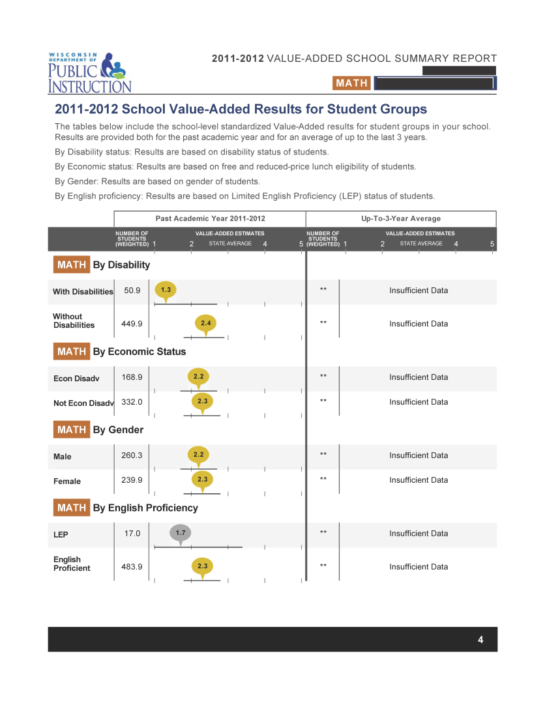
Pages 3 & 4 – Student Group Results (a.k.a. “Differential Effects”)
School-Level Value-Added Estimates for Student Group
Disability
Economic Status
Gender
English Proficiency
Notes:
Note: “by prior achievement level” and “by race/ethnicity” are not included yet in Wisconsin. We are still investigating the best method to bring those metrics to our statewide models.

Slide 111
Student Group Results
Also called “Differential Effects”, these results answer the following question:
How effective was my school at growing certain groups of students?

Slide 112
Overall Results (Constant Effects)
Prior Achievement
(Scale Scores)
FRL Status
My School
ELL Status
(by category)
SPED Status
(by severity level)
How much did my students grow compared to similar students from across Wisconsin?
Race/Ethnicity
Gender
Now, to demonstrate student group results, let’s consider the student group “female”

Slide 113
Step 1: Reduce Sample to Just Females
Prior Achievement
(Scale Scores)
FRL Status
My School
Females at
My School
ELL Status
(by category)
SPED Status
(by severity level)
Female students’ other demographic characteristics may be different than the school as a whole
Race/Ethnicity
Gender

Slide 114
Step 2: Student Group Results (Differential Effects): Gender = Female
Prior Achievement
(Scale Scores)
FRL Status
Females at
My School
ELL Status
(by category)
SPED Status
(by severity level)
How much did my female students grow compared to similar female students from across Wisconsin?
Race/Ethnicity
Gender

Slide 115
Scenario 1
Past Academic Year 2011-2012
Up-To-3-Year Average
NUMBER OF
STUDENTS
(WEIGHTED)
VALUE-ADDED ESTIMATES
NUMBER OF
STUDENTS
(WEIGHTED)
VALUE-ADDED ESTIMATES
1
2
3
4
5
1
2
3
4
5
READING
By Gender
Female
40.0
3.9
**
Insufficient Data
Female students at my school grew faster than similar female students from across Wisconsin

Slide 116
Scenario 2
Past Academic Year 2011-2012
Up-To-3-Year Average
NUMBER OF
STUDENTS
(WEIGHTED)
VALUE-ADDED ESTIMATES
NUMBER OF
STUDENTS
(WEIGHTED)
VALUE-ADDED ESTIMATES
1
2
3
4
5
1
2
3
4
5
READING
By Gender
Female
40.0
2.8
**
Insufficient Data
Female students at my school grew about the same as similar female students from across Wisconsin

Slide 117
Scenario 3
Past Academic Year 2011-2012
Up-To-3-Year Average
NUMBER OF
STUDENTS
(WEIGHTED)
VALUE-ADDED ESTIMATES
NUMBER OF
STUDENTS
(WEIGHTED)
VALUE-ADDED ESTIMATES
1
2
3
4
5
1
2
3
4
5
READING
By Gender
Female
40.0
1.6
**
Insufficient Data
Female students at my school grew slower than similar female students from across Wisconsin

Slide 118
Example Student Group Interpretation
Past Academic Year 2011-2012
Up-To-3-Year Average
NUMBER OF
STUDENTS
(WEIGHTED)
VALUE-ADDED ESTIMATES
NUMBER OF
STUDENTS
(WEIGHTED)
VALUE-ADDED ESTIMATES
1
2
3
4
5
1
2
3
4
5
READING
By Disability
With Disabilities
22.0
3.9
**
Insufficient Data
Without
Disabilities
160.9
2.3
**
Insufficient Data
At this school which student group is growing faster than their similar peers from across the state?
Does that mean the “With Disabilities” group grew more scale score points on the test than “Without Disabilities” group?
If the “With Disabilities” group is green or blue, does that mean we are closing the achievement gap with this group?
Notes:
The SPED group is growing faster than their similar peers. The Not SPED group is growing slower than their similar peers?
It does NOT mean that the SPED students grew more points than the Not SPED group. If across the state SPED students grew more slowly than Not SPED students, then just because this school had stronger than average growth with their SPED group, it does not mean the SPED group grew more test points that Not SPED students.
No, if SPED students are growing more slowly than Non-SPED students in the state, even if we’re faster than average the gap may still be widening.

Slide 119
Student Group Interpretation What Would You Do?
Past Academic Year 2011-2012
Up-To-3-Year Average
NUMBER OF
STUDENTS
(WEIGHTED)
VALUE-ADDED ESTIMATES
NUMBER OF
STUDENTS
(WEIGHTED)
VALUE-ADDED ESTIMATES
1
2
3
4
5
1
2
3
4
5
MATH
By English Proficiency
LEP
52.0
0.8
**
Insufficient Data
English
Proficient
130.9
2.2
**
Insufficient Data
What do these results mean?
If this was your school, how could you use these results to monitor instructional improvement?
Notes:
These results mean that at this school, LEP students are growing far below average compared to similar LEP students from across the state. Not LEP students are growing about average compared to other Not LEP students from across the state. Note that “LEP students have lower Value-Added estimates because in general, LEP students grow slower than Not LEP students” is incorrect reasoning. LEP growth at this school is lower than LEP growth at other schools.
This school might benefit from strategies geared at focusing/improving instruction for their English learner population. If possible, see if other schools in the district or in neighboring districts are having more success with their LEP populations. Maybe those instructional strategies could be used at this school to accelerate growth in this student group. After implementing new strategies, monitor LEP Value-Added to determine if this school is having greater success.

Slide 120
Page 5 – School-Level Scatter Plots
School-Level Value-Added and Achievement
Scatter Plot Interpretation

Slide 121
Overall Scatter Plots (Include new NAEP aligned proficiency cut scores)

Slide 122
How to Read the Scatter Plots
100
These scatter plots are a way to represent Achievement and
Value-Added together
Achievement
80
60
Percent Prof/Adv (2011)
Value-Added
40
20
0
1
2
3
4
5
Value-Added (2011-2012)
Notes:
The black lines represent average achievement and average Value-Added
The gray bars represent one standard deviation above and below that average

Slide 123
How to Read the Scatter Plots
A. Students know a lot and are growing faster than predicted
100
C
A
B. Students are behind, but are growing faster than predicted
80
E
C. Students know a lot, but are growing slower than predicted
60
Percent Prof/Adv (2011)
B
D. Students are behind, and are growing slower than predicted
40
D
E. Students are about average in how much they know and how fast they are growing
20
0
1
2
3
4
5
Schools in your district
Value-Added (2011-2012)
Notes:
The black lines represent average achievement and average Value-Added
The gray bars represent one standard deviation above and below that average

Slide 124
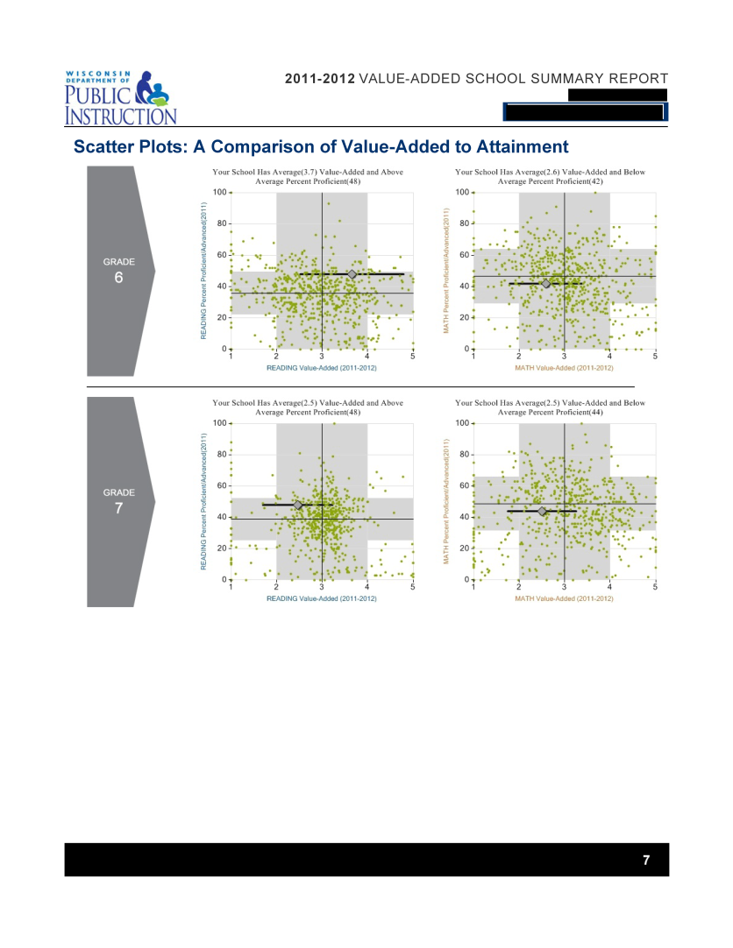
Page 6 (and 7 for some schools) – Grade-Level Scatter Plots
Grade-Level Value-Added and Achievement

Slide 125
Grade-Level Scatter Plots
Grade 3 Reading
Grade 3 Math

Slide 126
Last Section – Additional Information (1 of 2)
1-5 Value-Added Scale
Number of Students (Weighted)
Student Group Interpretation

Slide 127
Last Section – Additional Information (2 of 2)
Control Variables in the Model
Reasons for “Insufficient Data or NA”

Slide 128
Feedback Survey (for 8:30-10:30 session)
Please help us improve Value-Added training and resources for the future

Slide 129
VARC Resources
http://varc.wceruw.org/Projects/wisconsin_statewide.php
Content of these and other Power Points
Narrated videos
Online course preview
Link to online reporting tool
Example Reports
Example materials from other VARC projects

